Slide 1
How Do Family Medicine & Primary Care Influence Person & Population Health?
Kurt C. Stange, MD, PhD
Co-Director, Larry A. Green Center
Advancing Primary Health Care for the Public Good
Center for Community Health Integration
Research & Development for Community Health & Integrated, Personalized Care
Distinguished University Professor
Dorothy Jones Weatherhead Professor of Medicine
Professor of Family Medicine & Community Health, Population & Quantitative Health Sciences, Oncology, Sociology
Case Western Reserve University
kcs@case.edu

Slide 2
Overview
Motivation
Paradox of primary care
Possible mechanisms
  What emerges from whole person focus
  What emerges from relationship-centeredness
Asking patients & primary care clinicians
  11 aspects they say matters
  Simple rules

Slide 3
Motivation
Misunderstanding of what is important leads to a fragmented, impersonal healthcare system
  Stange KC. The problem of fragmentation and the need for integrative solutions. Ann. Fam. Med. 2009;7(3):100-103. www.annfammed.org/content/7/2/100
Many efforts to improve primary care make it worse
  Tarn DM, Wenger NS, Stange KC. Small solutions for primary care are part of a larger problem. Ann Intern Med. 2022. www.ncbi.nlm.nih.gov/pubmed/35759763
We can’t do it any more
  Bujold E. When practice transformation impedes practice improvement. Ann Fam Med. May-Jun 2015;13(3):273-5. www.annfammed.org/content/13/3/273
  Quick COVID-19 Survey: www.green-center.org/covid-survey
It’s time to stop enabling a dysfunctional system
  Stange KC. Time for family medicine to stop enabling a dysfunctional health care system. Ann Fam Med. 2023;21(3):202-204. www.annfammed.org/content/21/3/202
.

Slide 4
Paradox of Primary Care
Primary care is associated with:
Less evidence-based care for individual diseases,
But
More evidence-based care at the population level
Better population health
Lower resource use and cost
Less inequity in healthcare & health
Stange KC, Ferrer, RF. The paradox of primary care. Ann. Fam. Med. 2009;7(4):100-103.

Slide 5
Hypotheses
Possible Mechanisms

Slide 6
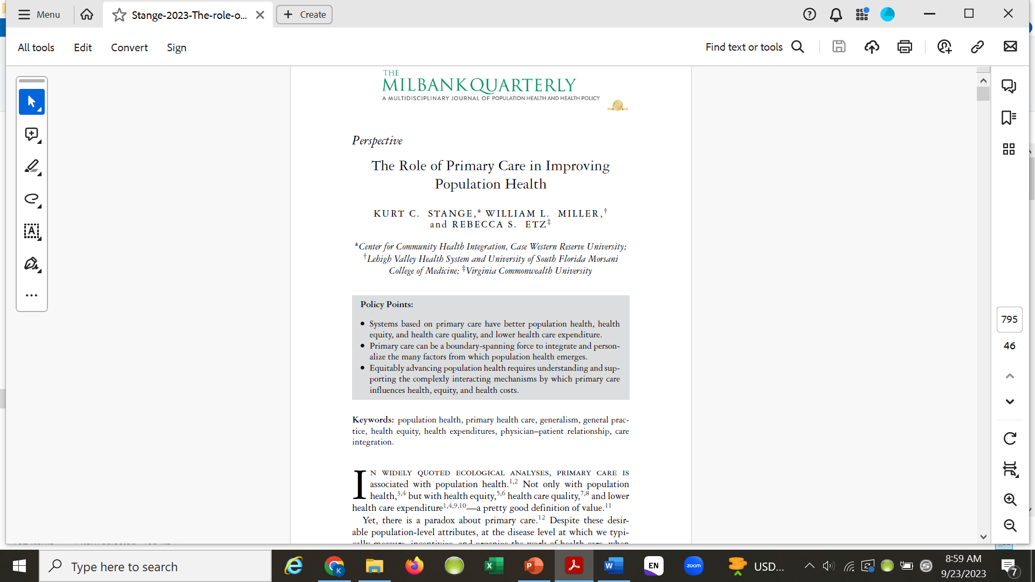
Stange KC, Miller WL, Etz RS. The role of primary care in improving population health. Milbank Q. 2023;101(S1):795-840. https://onlinelibrary.wiley.com/doi/10.1111/1468-0009.12638

Slide 7
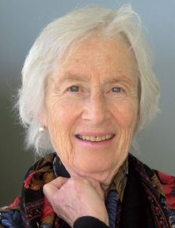
Principles of Primary Care – 4Cs
1st Contact accessibility
Comprehensiveness
Coordination
Continuity
Starfield B. Primary Care. Balancing Health Needs, Services and Technology. New York: Oxford University Press, 1998.
Stange KC, Nutting PA, Miller WL, et al. Defining and measuring the Patient-Centered Medical Home. J Gen Intern Med. 2010; 25(6): 601-612.
National Academies of Sciences, Engineering and Medicine. Implementing high-quality primary care: Rebuilding the foundation of health care. The National Academies Press; 2021.

Slide 8
Both And
Evidence-based care of single diseases
Care for acute & chronic illness
Individual
Process
Access
Commodity
Franchise
Borrowed knowledge
Scientific/systems ways of knowing
Competing demands
Generalist simple rules
Discipline
Attending to multiple problems & undifferentiated illness
Prevention, mental health
Family, Community, Population
Outcome
Continuity
Relationship
Different things in different contexts
Generalist knowledge
Personal ways of knowing
Competing opportunities
Specialist simple rules
Social movement

Slide 9
What emerges from a whole person focus?

Slide 10
Visits to Family Physicians
Variety of patients, problems and complexity
  Top 25 diagnostic clusters account for <50% of visits
10-minute average duration
Reason for visit
  58% acute illness
  24% chronic illness
  12% well care
Average patient paid 4.3 visits in the past year
Stange KC, Zyzanski SJ, Flocke SA, et al. Illuminating the ‘black box’: A description of 4454 patient visits to 138 family physicians. J Fam Pract, 1998; 46:377-389.

Slide 11
Opportunistic Preventive Service Delivery
32% of outpatient visits for illness
  Health habit advice (28%)
  Immunization (5%)
  Screening (4%)
No difference in patient satisfaction
Visits longer by 2.1 minutes
Stange KC, Flocke SA, Goodwin MA. Opportunistic preventive service delivery: Are time limitations and patient satisfaction barriers? J Fam Pract, 1998; 46:419-424.

Slide 12
Opportunistic Preventive Service Delivery
More common during visits by:
  Patients who smoke, drink or are overweight
  Patients with high-risk diseases
  New patients
  Patients with fewer visits in the past year
  Patients requesting preventive services
Less common during visits involving:
  Another family member
  Acute illness
  Prescription of a drug
Flocke SA, Goodwin MA, Stange KC. Predictors of opportunistic preventive service delivery J Fam Pract, 1998; 47:202-208.
Podl TR, Goodwin MA, Kikano GE, Stange KC. Direct observation of exercise counseling in community family practice. Am J Prev Med. 1999; 17:207-210.
Eaton CB, Goodwin MA, Stange KC. Direct observation of nutrition counseling in community family practice. Am J Prev Med, 2002; 23:174-179.
Jaén CR, Crabtree BF, Zyzanski SJ, Stange KC. Making time for tobacco counseling. J Fam Pract, 1998; 46:425-428.

Slide 13
Recent Emotional Distress
Reported by 19% of patients seeing a family physician
18% of these were diagnosed with anxiety or depression
Visit duration
  10 min - not distressed
  11.5 min - distressed, not diagnosed
  12.8 min - distressed and diagnosed
Dramatic differences in time use
Callahan EJ, Jaén CR, Goodwin MA, Crabtree BF, Stange KC. The impact of recent emotional distress and diagnosis of depression or anxiety on the physician-patient encounter in family practice. J Fam Pract, 1998; 46:410-418.

Slide 14
Recent Emotional Distress
Lower rates of
  Screening tests
Less time spent on
  Screening
  Tobacco counseling
Callahan EJ, Jaén CR, Goodwin MA, Crabtree BF, Stange KC. The impact of recent emotional distress and diagnosis of depression or anxiety on the physician-patient encounter in family practice. J Fam Pract, 1998; 46:410-418.

Slide 15
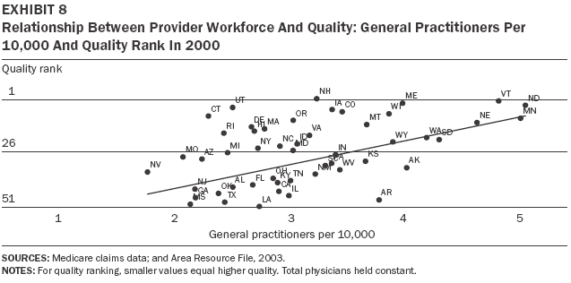
Baicker K, Chandra A. Medicare spending, the physician workforce, and beneficiaries’ quality of care. Health Affairs W4-185 - W4-197, 2004.

Slide 16
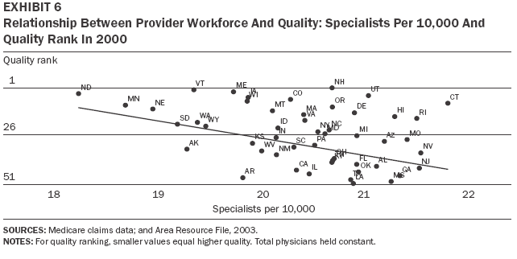
Baicker K, Chandra A. Medicare spending, the physician workforce, and beneficiaries’ quality of care. Health Affairs W4-185 - W4-197, 2004.

Slide 17
Primary care is adaptable to the people providing and receiving it, and manifests differently in different socio-political environments. e.g.
Extended general practice
Managed care enterprise
Reformed polyclinic
District health system
Community development agency
Franchised outreach
Meads G (2006) Primary Care in the Twenty-First Century: An international perspective. Oxford: Radcliffe Publishing.

Slide 18
Multiple Problems Per Visit
Average of 3 problems per visit
  37% >3 problems
  18% 4 problems
Special groups
  Patients >65 - 4 problems per visit
  Diabetics - 5 problems per visit
Beasley JW, Hankey TH, Erickson R, Stange KC, Mundt M, Elliott M, Wiesen P, Bobula J. How many problems do family physicians manage at each encounter? Ann Fam Med, 2004; 2;405-410.
Flocke SA, Frank SH, Wenger DA. Addressing multiple problems in the family practice office visit. J Fam Pract. 2001; 50:211-216.

Slide 19
Visits by Diabetic Patients in a CHC
Mean of 25 problems (range 13 to 32)
Wide variety of issues
  Biomedical – acute & multiple chronic illnesses
  Behavioral
  Social
  System
  Environmental health
Bolen SD, Sage P, Perzynski AT, Stange KC. No Moment Wasted: The Primary Care Visit for Adults with Diabetes. Primary Healthcare Research & Development. 2015; May 20:1-15.

Slide 20
Prioritizing
 BP
 Cholesterol
 Glycosylated Hgb
Screening for
 Tobacco
 Alcohol
 Other substances
 Depression/anxiety
Coaching about
 Physical activity
 Diet
Bolen SD, Sage P, Perzynski AT, Stange KC. No moment wasted: the primary-care visit for adults with diabetes and low socio-economic status. Primary Health Care Research & Development. 2016;17(1):18-32.
Donner-Banzhoff N. Solving the Diagnostic Challenge: A Patient-Centered Approach. Ann Fam Med. 2018 Jul;16(4):353-358.

Slide 21
Competing Demands Theory
Many worthwhile services compete with each other for time on the agenda of primary care patient visits.
When clinicians are not doing one thing under scrutiny, at times they are doing something more salient or important.
Jaén CR, Stange KC, Nutting PA. The competing demands of primary care: A model for the delivery of clinical preventive services. J Fam Pract. 1994; 38:166-171.

Slide 22
Competing Demands & Tobacco Counseling
Hierarchy of taken & missed opportunities
  Good (5As) counseling: 21%
  Competing demands: 24%
  Failure in a non-smoking related visit 27%
  Failure in a smoking-related visit 25%
  Failure in a health maintenance visit 2%
Guidelines to counsel every visit unrealistic
Systems & individual approaches are needed
Jaén CR, McIlvain H, Pol L, Phillips RL, Flocke SA, Crabtree BF. Tailoring tobacco counseling to the competing demands in the clinical encounter. J Fam Pract, 2001; 50:859-863.

Slide 23
Theory of Competing Opportunities
Integrated, prioritized care within an ongoing personal relationship
  Breadth of care
  Depth of knowledge of the patient, family and community over time
  Bridging of the boundaries between health and illness
  Guiding access to more narrowly focused care
Stange KC, Jaén CR, Flocke SA, Miller WL, Crabtree BF. The value of a family physician. J Fam Pract, 1998; 46:363-368.

Slide 24
What emerges from relationship?

Slide 25
Typology of Physicians based on Philosophy & Management Skills
Philosophy
Biomedical
Biopsychosocial
Technician | Friend
Detective | Healer
Basic
Skill Set
Advanced
Robinson WD, Priest LA, Susman JL, Rouse J, Crabtree BF. Technician, friend, detective, and healer: family physicians' responses to emotional distress. J. Fam. Pract. 2001;50(10):864-870.

Slide 26
Continuity of Care
Lower total healthcare expenditures
Lower rates of ED use & hospitalization
Better 146 other outcomes
Gaglioti AH, Li C, Baltrus PT, et al. Interpersonal primary care continuity for chronic conditions is associated with fewer hospitalizations and emergency department visits among Medicaid enrollees. J Am Board Fam Med. 2023;36(2):303-312.
Bazemore A, Merenstein Z, Handler L, Saultz JW. The impact of interpersonal continuity of primary care on health care costs and use: A critical review. Ann Fam Med. 2023;21(3):274-279.
Bazemore A, Petterson S, Peterson LE, Bruno R, Chung Y, Phillips RL, Jr. Higher Primary Care Physician Continuity is Associated With Lower Costs and Hospitalizations. Ann Fam Med. Nov 2018;16(6):492-497.

Slide 27
The Family in Family Practice
Is alive and well by multiple measures
  10% of time
  Family members present during 34% of visits
  Genograms in 11% of medical records
Family history obtained in visits by:
  51% of new patients
  22% of established patients
Medalie JH, Zyzanski SJ, Langa DM, Stange KC. The family in family practice: Is it a reality?
Results of a multi-faceted study. J Fam Pract, 1998; 46:390-396.

Slide 28
Family Focus - Two Styles
Family history as context for care of individuals
  Higher preventive service delivery rates
Family as the unit of care
  Greater knowledge of the patient and family
Medalie JH, Zyzanski SJ, Goodwin MA, Stange KC. Patient outcomes from two different styles of family focus. J Fam Pract, 2000; 46:209-215.

Slide 29
The “Secondary Patient”
Family members other than the identified patient
18% of outpatient visits
Care of secondary patient
  Advice, information, explanation
  Prescription
  Follow-up of a previous episode of care
  Visits longer by 1.3 minutes
No difference in primary patient’s
  Preventive service delivery
  Satisfaction
  Billing
Flocke SA, Goodwin MA, Stange KC. The effect of a secondary patient on the family practice visit. J Fam Pract, 1998; 46:429-434.
Orzano AJ, Gregory PM, Nutting PA, Werner JJ Flocke SA, Stange KC. Care of the secondary patient in family practice: A report from the Ambulatory Sentinel Practice Network J Fam Pract, 2001; 50:113-116.

Slide 30
Relationship
Longitudinality
“This doctor and I have been through a lot together.”
Mainous AG, Goodwin MA, Stange KC. Patient-physician shared experiences and value patients place on continuity of care. Annals of Family Medicine. 2004;2(5):452-454.

Slide 31
Healing
Cure when possible
Transcendence of suffering
Egnew TR. The meaning of healing: transcending suffering. Ann Fam Med. 2005;3(3):255–262.
Egnew TR. Suffering, meaning, and healing: challenges of contemporary medicine. Ann Fam Med. 2009;7(2):170–175.
Scott JG, Cohen D, Dicicco-Bloom B, Miller WL, Stange KC, Crabtree BF. Understanding healing relationships in primary care. Ann Fam Med. 2008;6(4):315–322.
Scott JG, Scott RG, Miller WL, Stange KC, Crabtree BF. Healing relationships and the existential philosophy of Martin Buber. Philos Ethics Humanit Med. 2009;4:11.
Scott JG, Warber SL, Dieppe P, Jones D, Stange KC. Healing journey: a qualitative analysis of the healing experiences of Americans suffering from trauma and illness. BMJ Open. 2017;0:e016771.

Slide 32
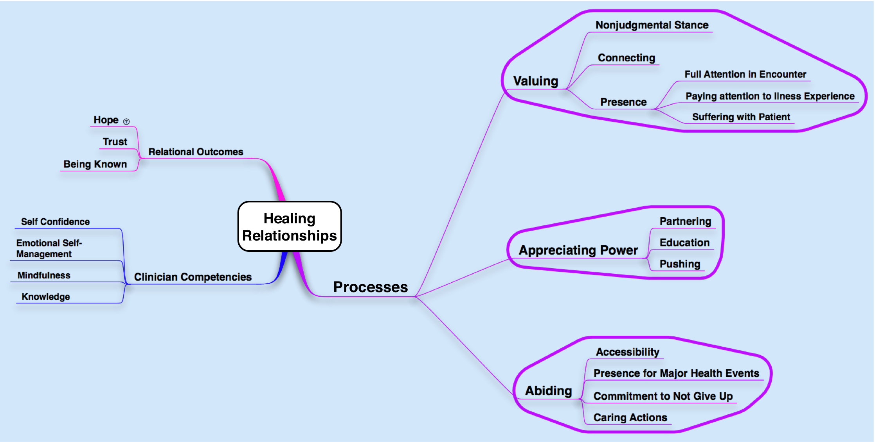
Healing Relationships
Scott JG, Cohen D, Dicicco-Bloom B, Miller WL, Stange KC, Crabtree BF. Understanding healing relationships in primary care. Ann Fam Med. 2008;6(4):315–322.

Slide 33
Holarchy of Health Care
Healing and Transcendence
Abiding even when healing cannot be fostered
Relationship-centered Care
Fostering healing
Integrating biotechnical & biographical care based on deep knowledge of both & connections to others
Prioritized Care
Goal-oriented Care
Balancing individual, family, community & system needs & opportunities
Integrated Care
Integrating care across acute & chronic illness, prevention & mental health
Management of multimorbidity
Patient-centered Care
Psychosocial care
Proactive management of prevention & chronic illness
Care of acute illness
Management of patient concerns
Fundamental Healthcare
Physician-centered Care
Stange KC. A science of connectedness. Ann Fam Med. 2009;7(5):387-395.

Slide 34
Investing in relationship
Many ways
Many don’t require continuity
  Quality of attention
  Structure of the time during the visit
  How care is organized
Bergman D, Bethell C, Gombojav N, Hassink S, Stange KC. Physical Distancing With Social Connectedness. Ann Fam Med. May 2020;18(3):272-277. www.ncbi.nlm.nih.gov/pubmed/32393566

Slide 35
Measuring what matters

Slide 36
Developing a New Primary Care Measure
Begin by “crowd sourcing”
  asking diverse stakeholders what is important to them about good quality care
International multi-stakeholder conference
  Starfield III
Ethnographic analysis by a multidisciplinary team
Two ways of measuring what provides value
  Simple rules
  A simple set of measures for patients to report
www.starfieldsummit.com/starfield3/ (Measures & report available under “Resources” tab.)

Slide 37
Person-Centered Primary Care Measure
- Primary Care Mechanisms Assessed by Patients -
My practice makes it easy for me to get care.
My practice is able to provide most of my care.
In caring for me, my doctor considers all of the factors that affect my health.
My practice coordinates the care I get from multiple places.
My doctor or practice know me as a person.
My doctor and I have been through a lot together
My doctor or practice stand up for me.
The care I get takes into account knowledge of my family.
The care I get in this practice is informed by knowledge of my community.
Over time, this practice helps me to meet my goals.
Over time, my practice helps me stay healthy.
Etz RS, Zyzanski SJ, Gonzalez MM, Reves SR, O’Neal JP, Stange KC. A New Comprehensive Measure of High-Value Aspects of Primary Care. The Annals of Family Medicine. 2019;17(3):221-230. www.annfammed.org/content/17/3/221
https://www.green-center.org/pcpcm

Slide 38
Factor Analysis of Patient-Report Items
How Primary Care Works - Item | Factor Loading | Item-Total Correlation
My practice makes it easy for me to get care. | .70 | .67
My practice is able to provide most of my care. | .70 | .66
In caring for me, my doctor considers all of the factors that affect my health | .80 | .76
My practice coordinates the care I get from multiple places. | .64 | .62
My doctor or practice know me as a person. | 83 | .81
My doctor and I have been through a lot together | .66 | .64
My doctor or practice stand up for me. | .85 | .83
The care I get takes into account knowledge of my family. | .80 | .78
The care I get in this practice is informed by knowledge of my community. | .71 | .70
Over time, this practice helps me to meet my goals. | .85 | .82
Over time, my practice helps me stay healthy. | .85 | .81
Principal components factor analysis reveals a single factor
with an Eigen value of 6.85
accounting for 59% of the variance.
Alpha=.94.
Notes:
There is a dominant single factor with an
Eigen value of 6.85 accounting for 59% of the variance in the data
matrix. The second Eigen value is trivial.
In psychometrics, a factor loading of 0.4 is the minimum
for a variable to be considered loading on that factor.
A loading of 0.6 is considered a strong loading useful
in defining the factor. Note, our 11 items all have loadings >.6.
Strong evidence of a single factor.
The alpha reliability of .94 for the 11 item scale.
The Item-total statistics (Corrected item-total
correlations). This represents the correlation of each item with the sum of the other items (i.e., with the item itself removed). One would expect that if each item was measuring a common factor, each item should correlate
substantially with the sum of the other 10 items. Note these
correlations are all >0.6, where there is not a single weak item in
the pool.

Slide 39

Notes:
This is the mesmerising moment a murmuration of starlings took the form of a giant bird while being targeted by a bird of prey.
Daniel Biber, 53, captured the breathtaking snap after observing thousands of birds and scouting locations over a four-day period.
Like clouds in the sky, the giant flocks often take on weird and wonderful - and sometimes graphic - moving forms and shapes.
And the birds made for a startling spectacle when they assembled over the Costa Brava in northeastern Spain in front of Mr Biber's eyes.
He managed to take a series of images which show the birds merging into the shape of a giant bird when they were targeted by a predator.
And the unique snap has since earned him the top prize in an international photography competition.
But Mr Biber said he only realised his luck once he reviewed the photographs on his computer.
He said: "I was taking pictures of the murmurations over several days.
"Only when I checked the pictures on the computer later, I realised what formation the starlings had created.
"I was so concentrated on taking pictures at the time that I hadn't realised that the starlings had created a giant bird in the sky.
"It took less than 10 seconds for the birds to create that formation.
"I realised that I had captured a unique snapshot, technically, sharp and in high quality."
Mr Biber lives in Hilzingen, Germany, and now runs a bicycle business following his career as an aerospace engineer.
He has been taking pictures since 1981 when he started off with his first reflex camera and has been taking digital snaps since 2008.
Mr Biber has visited the northeast of Spain for a number of years and knew about the fascinating display that starlings put on.
But he said it took him four days to capture the unique moment after he had to scout out locations and get the lighting right.

Slide 40
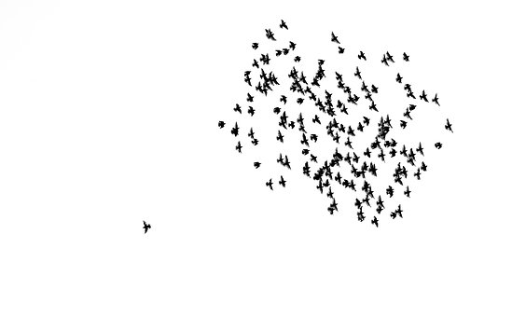
Simple Rules – Birds Flocking
Alignment – first, look to line up with those close by
Cohesion – next, steer towards center mass of those around you
Separation – finally, seek to be equi-distant from your neighbors so you don’t collide

Slide 41
Etz R, Miller WL, Stange KC. Simple rules that guide generalist and specialist care. Fam Med. 2021;53(8):697-700. https://journals.stfm.org/familymedicine/2021/september/stange-2020-0588/
Simple Rules
Specialist Rules
Identify & classify disease for management
Interpret through specialized knowledge
Manage a plan for disease care
Generalist Rules
Recognize & make sense of problems/opportunities
Prioritize attention/action to promote:
  Health
  Healing
  Connection
Personalize care based on the particulars of the person in their family & community context

Slide 42


Slide 43

Notes:
[Picture of ducklings peering over an obstruction.]

Slide 44
Extra Slides

Slide 45
Generalism Model of Health Care
Ways of Doing: Access, Time, Context, Approach
Ways of being:
Reflexivity
Interpretive processes
Virtuous character
Biotechnical
way
of knowing
Biographical
way
of knowing
Gunn JM, Palmer VJ, Naccarella L, et al. The promise and pitfalls of generalism in achieving the Alma-Ata vision of health for all. Med J Aust. 2008;189(2):110-112.

Slide 46
Generalism Model of Health Care
Ways of Doing: Access, Time, Context, Approach
Ways of being:
Reflexivity
Interpretive processes
Virtuous character
Biographical
way
of knowing
Biotechnical
way
of knowing
Gunn JM, Palmer VJ, Naccarella L, et al. The promise and pitfalls of generalism in achieving the Alma-Ata vision of health for all. Med J Aust. 2008;189(2):110-112.

Slide 47
Principles of Family Medicine
Family physicians are committed to the person
  rather than a particular body of knowledge, group of dis
Family physicians seek to understand the context of the illness
Family physicians see every contact with the patient as an opportunity for prevention or health education
Family physicians view their practice as a population
Freeman T, McWhinney IR. McWhinney's textbook of family medicine. Fourth Ed. ed, 2016.

Slide 48
Principles of Family Medicine
Family physicians see themselves as part of a community-wide network of supportive and health care agencies
Ideally, family physicians share the same habitat as their patients
Family physicians see patients in their homes
Family physicians attach importance to the subjective aspects of medicine
Family physicians act as a manager of resources
Freeman T, McWhinney IR. McWhinney's textbook of family medicine. Fourth Ed. ed, 2016.

Slide 49
The Generalist Way
Being
  Open, humble, connected
Knowing
  iterates between whole & particulars
Perceiving
  Scanning, prioritizing
  Focusing on particulars while keeping the whole in view
Thinking & Doing
  Contextualizing, connecting, integrating
Stange KC. The Generalist Approach. Ann Fam Med. 2009;7(3):198-203.
Gunn JM, Palmer VJ, Naccarella L, et al. The promise and pitfalls of generalism in achieving the Alma-Ata vision of health for all. Med J Aust. Jul 21 2008;189(2):110-2.

Slide 50
Types of Patient Encounters
Routines
  Simple, brief, contractual, biomedical, “bread & butter”
Ceremonies
  Maintenance
    Well care, prenatal care, chronic disease follow-up…
  Transitional
    “Schedule busters,” “Hidden time bombs,” “Oh, by the way,”
    Surprise, new diagnosis of a chronic disease, revelation…
    Often sets up a drama
Dramas
  Crisis, conflict, major life change happening/impending
  Family often convened
Miller WL. Routine, ceremony, or drama: an exploratory field study of the primary care clinical encounter. J Fam Pract. 1992;34(3):289-296.

Slide 51
Primary Care: How It Works
CONTEXT
COMPREHENSIVE INTEGRATION
OUTCOMES
Community/Pt. Pop.
Socioeconomic status
Needs
Values
Acute problems
Chronic illnesses
Family Members
Psychosocial and social needs
Prevention
Coordination of more narrowly focused care
Individual
Optimization, within personal values & circumstances, of:
  Functional health
  Well-being
  Longevity
  Social role function
  Risk factors
  Satisfaction with care
  Acceptance of what cannot be changed
  Life goals
Health Care System
Payment
Access to general&special services
Information systems
Support/hassle
Equality
PRIORITIZED & INDIVIDUALIZED CARE
Practice Environment
Communications
Competent, caring staff
Support of care & relationships
Accessibility
RELATIONSHIPS
That Personalize Care
System
Cost effectiveness
Population health
Equity
Sustainability
Family Physician
Personal characteristics
Training
Biomedical competency
Interpersonal Skills
Knowledge of patients’ unique risks, values, resources
Community & family context

Slide 52
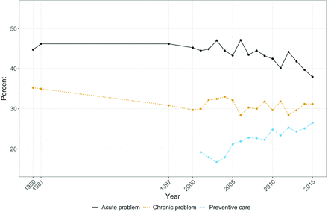
Visit types over time
Bensken WP, Dong W, Gullett H, Etz RS, Stange KC. Changing Reasons for Visiting Primary Care Over a 35-Year Period. J Am Board Fam Med. Mar-Apr 2021;34(2):442-448. https://www.jabfm.org/node/12920.full

Slide 53
Current Efforts to Improve Quality of Care
Disease management programs
Disease-specific pay-for-performance
Increase access to specialty care
Carve outs
Brook RH, McGlynn EA, Cleary PD. Quality of health care: Part 2: Measuring quality of care. N Engl J Med. 1996;335:966-969.
Stange KC. The paradox of the parts and the whole in understanding and improving general practice. Int J Qual Health Care, 2002; 14(4):267-268.
Aron D, Pogach L. Specialists versus generalists in the era of pay for performance: “A plague o’ both your houses!” Qual Saf Health Care. 2007;16:3-5.

Slide 54
Community-Oriented Primary Care
Links primary care, epidemiology, public health
Community for which practice assumes responsibility
Four steps
  Define & characterize the community
  Describe community health problems
  Modify health care to address high-priority needs
  Monitoring effectiveness of program modifications
Many successes
No infrastructure for widespread implementation
Geiger HJ. Community-oriented primary care: a path to community development. Am J Pub Health. 2002;92(11):1713 - 1716.
Rhyne R, Bogue R, Kukulka G, Fulmer H, eds. Community-Oriented Primary Care: Health Care for the 21st Century. American Public Health Association; 1998.
Nutting PA. Community-oriented primary care: an integrated model for practice, research, and education. Am J Prev Med. 1986;2(3):140-7.
Longlett SK, Kruse JE, Wesley RM. Community-oriented primary care: historical perspective. J Am Board Fam Pract. Jan-Feb 2001;14(1):54-63.

Slide 55
Direct Primary Care
Patients pay a monthly, quarterly, or annual fee that covers all or most primary care services
Often combined with high deductable insurance
Results
  More time with patients
  Low overhead; no insurance filing
Direct Primary Care Coalition. www.dpcare.org
Wu WN, Bliss G, Bliss EB, Green LA. Practice profile. A direct primary care medical home: the Qliance experience. Health Aff (Millwood). 2010 May;29(5):959-62. http://content.healthaffairs.org/content/29/5/959.full

Slide 56

Franchising Primary Care
The Patient-Centered Medical Home
  A political construct
Future of Family Medicine Project
  ‘New Model’ of care
Venture Capital funded
  ChenMD, CityBlock, Oak Street Health
Robert Graham Center. The PCMH: History, seven core features, evidence and transformational change. Washington, DC; 2007. www.graham-center.org/online/graham/home/publications/monographs-books/2007/rgcmo-medical-home.html
Stange KC, Miller WL, Nutting PA, Crabtree BF, Stewart EE, Jaén CR. Context for understanding the National Demonstration Project and the Patient-Centered Medical Home. Ann Fam Med. 2010;8(Suppl 1):S2-S8. www.annfammed.org/cgi/content/full/8/Suppl_1/S2
PCPCC. Shared Principles of Primary Care. https://www.pcpcc.org/about/shared-principles
PCPCC. Results & Evidence. https://www.pcpcc.org/results-evidence
Stange KC, Nutting PA, Miller WL, et al. Defining and measuring the Patient-Centered Medical Home. J Gen Intern Med. 2010; 25(6): 601-612.
Martin JC, Avant RF, Bowman MA, et al. The Future of Family Medicine: a collaborative project of the family medicine community. Annals of Family Medicine. Mar-Apr 2004;2 Suppl 1:S3-32.

Slide 57
Borrowed AND Generalist
Knowledge
Borrowed knowledge
  Primary care as a problem to be solved
  0.4% of NIH budget
Generalist knowledge
  Primary care as a force for integration
  to be understood and supported

Slide 58
4 Ways of Knowing
Inner Reality
Outer Reality
Individual
“I”
“It”
Collective
“We”
“Its”
Adapted from:
Wilber, K. Sex, Ecology, Spirituality. 1995/2000, Boston: Shambhala Publications, Inc.
Wilber, K. A Brief History of Everything. 1996, Boston: Shambhala Publications, Inc.

Slide 59
4 Ways of Knowing
About Health & Health Care
“It”
Disease, Treatment
“I”
Patient, Clinician, Worker, Policymaker
“We”
Family, Practice, Team, Community
“Its”
Systems, Organization
Adapted from:
Stange KC, Miller WL, McWhinney I. Developing the knowledge base of family practice. Fam Med. 2001; 33(4):286-297.
Stange KC. Ways of knowing, learning, and developing. Ann. Fam. Med. Jan-Feb 2010;8(1):4-10.

Slide 60

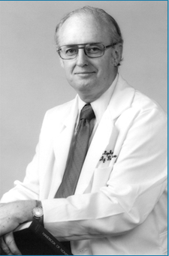

Slide 61
“The family practice movement has succeeded in the decade just past because we were identified with reforms that are more pervasive and powerful than ourselves.”
“I am convinced that the emergence of family practice was a response to ideas whose time had come and that our continued success is dependent on our ability to identify what they are, and to facilitate their expression, not to manage, control, or own them.”
Stephens GG. Family medicine as counterculture. Fam Med. 1989;21(2):103-109.

Slide 62
Notes:
[Picture of ducklings peering over an obstruction.]

Slide 63
Methods
Working at the interface of QI & research
Participatory approaches
Measuring what matters
Modeling complexity
Numbers & narratives

Slide 64
Working at the interface of QI & research
Difference between quality improvement & research
  Local or transportable new knowledge?
  IRB
Develop clinical laboratories & learning communities
Mold JW, Peterson KA. Primary care practice-based research networks: working at the interface between research and quality improvement. Ann Fam Med. 2005;3 Suppl 1:S12-20.

Slide 65
Participatory approaches
Practice-based research networks
Community-based participatory research
Nutting PA, Green LA. Practice-based research networks: reuniting practice and research around the problems most of the people have most of the time. J Fam Pract. 1994;38(4):335-336.
Nutting PA, Beasley JW, Werner JJ. Practice-based research networks answer primary care questions. JAMA. 1999;281(8):686-688.
Green LA, White LL, Barry HC, Nease DE, Jr, Hudson BL. Infrastructure requirements for practice-based research networks. Ann Fam Med. 2005;3 Suppl 1:S5-11.
Agency for Healthcare Research and Quality. AHRQ Practice-Based Research Networks (PBRNs). AHRQ Publication No. 01-P020. Agency for Healthcare Research and Quality, Rockville, MD. http://www.ahrq.gov/cpi/initiatives/pbrn/index.html
Westfall JM, VanVorts RF, Main DS, Herbert C. Community-based participatory research in practice-based research networks. Ann Fam Med. 2006;4(1):8-14.
Israel BA, Eng E, Schulz AJ, Parker EA. Methods for Community-Based Participatory Research for Health. 2nd ed. Wiley; 2012.
Macaulay AC, Commanda LE, Freeman WL, et al. Participatory research maximises community and lay involvement. North American Primary Care Research Group. BMJ. 1999;319(7212):774-778

Slide 66
Modeling complexity

Slide 67
Complex Systems Modeling
Simulation – hybrid computer models
  Agent-based
  System dynamics
  Social network analysis
Participatory group model building
Test hypotheses about complexly-related primary care mechanisms & outcomes
Homa L, Rose J, Hovmand PS, et al. A participatory model of the paradox of primary care. Ann Fam Med 2015; 456-465.
Stange KC, Cherng ST, Riolo RL, et al. No longer looking just under the lamp post: modeling the complexity of (primary) health care. In: Kaplan G, Diez-Roux A, Galeo S, Simon C, eds. Growing Inequality: Bridging Complex Systems, Population Health, and Health Disparities. Washington, D.C., Westphalia Press, 2017. pp 81-107.

Slide 68
An Agent-Based Model of Primary Care
Group model building
  Patients are at risk for acute illness, acute life-changing illness, chronic illness, and mental
  Patients have changeable health behaviors and care-seeking tendencies that relate to their living in advantaged or disadvantaged neighborhoods.
  There are 2 types of care available to patients: primary and specialty.
    Primary care in the model is less effective than specialty care in treating single diseases, but it has the ability to treat multiple diseases at once.
    Primary care also can provide disease prevention visits, help patients improve their health behaviors, refer to specialty care, and develop relationships with patients that cause them to lower their threshold for seeking care.
Model runs
  With primary care features turned off, primary care patients have poorer health.
  With all primary care features turned on, their conjoint effect leads to better population health for patients who seek primary care,
    The primary care effect being particularly pronounced for patients who are disadvantaged and patients with multiple chronic conditions.
    Primary care leads to more total health care visits that are due to more disease prevention visits, but there are reduced illness visits among people in disadvantaged neighborhoods.
Homa L, Rose J, Hovmand PS, et al. A participatory model of the paradox of primary care. Ann Fam Med 2015; 456-465.

Slide 69
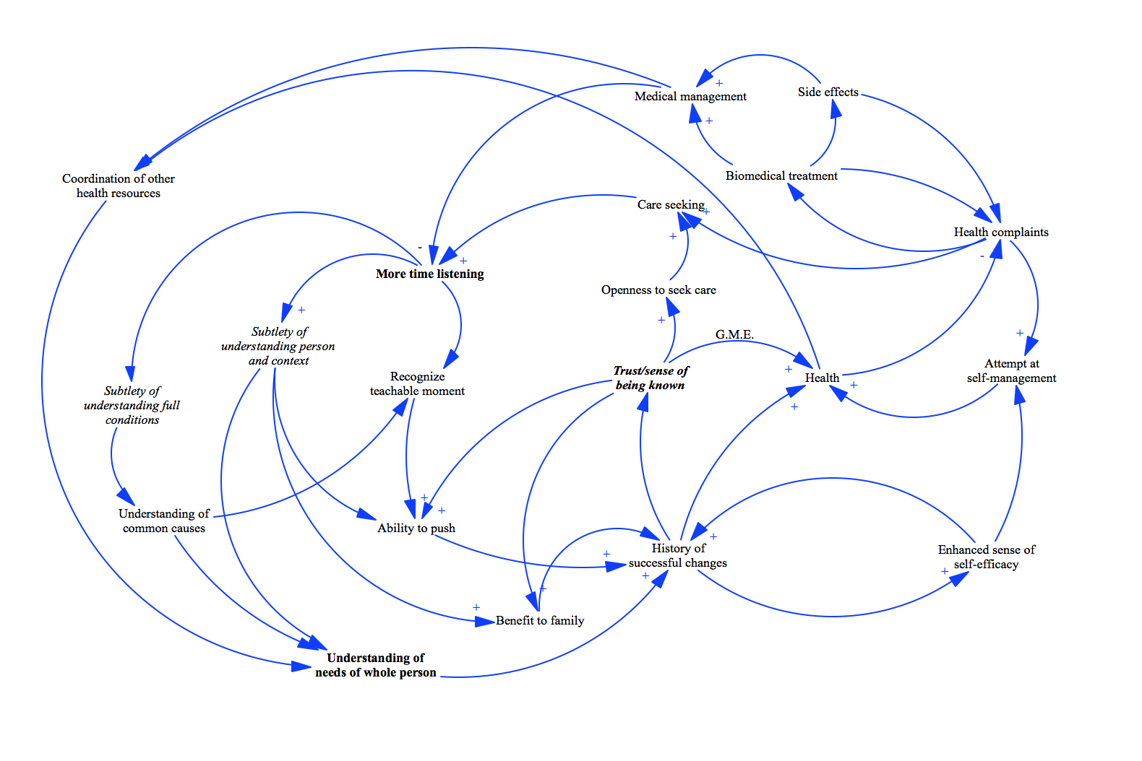
Community-Based System Dynamics
Hovmand PS. Community Based System Dynamics. Springer,; 2014
Stange KC, Cherng ST, Riolo RL, et al. No longer looking just under the lamp post: modeling the complexity of primary health care. In: Kaplan GA, Diez Roux AV, Simon CP, Galea S, eds. Growing Inequality: Bridging Complex Systems, Population Health, and Health Disparities. Washington, DC: Westphalia Press; 2017:81-107.

Slide 70
Numbers & narratives

Slide 71
Multimethod Research
Quantitative methods
  Counting descriptions
  Testing a priori hypotheses
  Seek to isolate phenomenon from context
Qualitative methods
  Rich descriptions
  Discovery; testing evolving hypotheses
  Seek to understand meaning and context
Integrated use
  Qualitative, then quantitative
  Quantitative, then qualitative
  Simultaneous
Stange KC, Zyzanski SJ. Integrating qualitative and quantitative research methods. Fam Med, 1989;21:448-451.
Stange KC, Miller WL, Crabtree BF, O’Connor PJ, Zyzanski SJ. Multimethod research: Approaches for integrating qualitative and quantitative methods. J Gen Intern Med. 1994; 9:278-282.
Crabtree BF, Miller WL, Stange KC. Understanding practice from the ground up. J Fam Pract, 2001;50:881-887.
Stange KC, Crabtree BF, Miller WL. Publishing multimethod research. Ann Fam Med. 2006;4(4):292-294.

Slide 72
A Few
Take-Away Points

Slide 73
Review
Different views of population health
Paradox of primary care
Possible mechanisms
  Breadth + drilling down
  Prioritizing
  Contextualizing
  Systemic + personal connectedness
Methods
  Measuring what matters
  Modeling complexity
  Numbers & Narratives

Slide 74
Policy Points
Systems based on primary care have
  Better population health
  Greater health equity
  Better healthcare quality
  Lower health care expenditure
Primary care can be a boundary spanning force to integrate and personalize the many factors from which population health emerges.
Equitably advancing population health requires understanding and supporting the complexly interacting mechanisms by which primary care influences health, equity, and health service costs.
Stange KC, Miller WL, Etz RS. The role of primary care in improving population health. Milbank Q. 2023;101(S1):795-840. https://onlinelibrary.wiley.com/doi/epdf/10.1111/1468-0009.12638

Slide 75
Implications
To get the benefits of primary care for:
  Population health
  Equity
  Quality
  Sustainability
Support frontlines primary care with:
  Understanding of its complex role/functions
  Relevant information
  Time
  Investment in relationship
  Iteration between the parts and the whole

Slide 76
Family medicine is population health,
one person at a time.
Larry Bauer, MSW

Slide 77
The Ecology of Medical Care
1000 persons
800 report symptoms
327 consider seeking medical care
217 visit a physician office (113 visit a primary care physician’s office)
65 visit a complementary or alternative medical care provider
21 visit a hospital outpatient clinic
14 receive home health care
13 visit an emergency dept
8 are hospitalized
<1 is hospitalized in an academic medical center
Results of a reanalysis of the monthly prevalence of illness in the community and the roles of various sources of health care. (Green LA et al., N Engl J Med 2001, 344:2021-2024)
Notes:
The slide shows the ecology of health care.
Within it, it contains the rationale for PBRNs.
Out of 1000 people living in community, in a given month:
800 report symptoms.
327 consider seeking medical care
217 visit a medical office – half of these are primary care
And so on..
Only 1 is hospitalized in an academic medical center. And yet, that is where we do almost all research.
If we want research to be relevant to practice and to where ‘most people get most of their care most of the time’ we need to frame and conduct the research in the box of 217.

Slide 78
Primary Care is [NASEM Definition]:
High quality primary care is the provision of whole-person, integrated, accessible, and equitable health care by interprofessional teams that are accountable for addressing the majority of individual’s health and wellness needs across settings and through sustained relationships with patients, families, and communities.
National Academies of Sciences, Engineering and Medicine. Implementing high-quality primary care: Rebuilding the foundation of health care. Washington, DC: The National Academies Press; 2021.
https://www.nap.edu/catalog/25983/implementing-high-quality-primary-care-rebuilding-the-foundation-of-health

Slide 79
Emerging Models of Primary Care
Many on-the-ground practice innovations
Patient/person empowerment
Technology-amplified
Policy innovations that interact with primary care
Foundation of an integrated health care system
Community health centers
Focused on special populations
By groups, corporations
Hot-spotting
PCMH
Direct primary care

Slide 80
Primary Health Care Activity Monitor for Europe
Structure
  Governance
  Economic conditions
  Workforce development
Process
  Access
  Continuity
  Coordination
  Comprehensiveness
Kringos DS, Boerma WGW, Hutchinson A, Saltman RB, eds. Building primary care in a changing Europe. Copenhagen, Denmark: WHO; 2015.
Kringos D, Boerma W, Bourgueil Y, et al. The strength of primary care in Europe: an international comparative study. Br J Gen Pract. 2013;63(616):e742-750.

Slide 81
Primary Health Care Activity Monitor for Europe
Outcomes
  Better population health
  Lower rates of unnecessary hospitalizations
  Lower socioeconomic inequality
Costs
  Higher
  Slower growth
Subgroup benefit- people with multimorbidity
Kringos DS, Boerma WGW, Hutchinson A, Saltman RB, eds. Building primary care in a changing Europe. Copenhagen, Denmark: WHO; 2015.
Kringos DS, Boerma W, van der Zee J, Groenewegen P. Europe's strong primary care systems are linked to better population health but also to higher health spending. Health Aff (Millwood). 2013;32(4):686-694.
Hansen J, Groenewegen PP, Boerma WG, Kringos DS. Living In A Country With A Strong Primary Care System Is Beneficial To People With Chronic Conditions. Health Aff (Millwood). 2015;34(9):1531-1537.

Slide 82
Assessing Contextual factors
Ask 2 questions:
1. What contextual factors do we need to know to understand what happened here and why?
2. What would someone else need to know to transport/re-invent what we learned here in a different time and place?
Consider what is important across
  multiple levels
  times
  perspectives
Stange KC, Glasgow RE. Considering and Reporting Important Contextual Factors in Research on the Patient-Centered Medical Home. Rockville, MD: Agency for Healthcare Research and Quality. May 2013. ARHQ Publication No. 13-0045-EF. http://pcmh.ahrq.gov/portal/server.pt/community/pcmh__home/1483/Contextual_Factors> .
Tomoaia-Cotisel A, Scammon DL, Waitzman NJ, et al. Context Matters: The Experience of 14 Research Teams in Systematically Reporting Contextual Factors Important for Practice Change. Ann Fam Med. 2013;11(Suppl 1):S115-S123.

Slide 83
Assess Context:
Across Multiple Levels
Patient population and expectations
Practice
Networks of practices (ownership, affiliations)
Local & regional health care systems
Relationship of intervention or evaluation team with participants
Communities
Relevant geopolitical entities and policy context (State, regional, city)

Slide 84
Assess Context:
Across Multiple Time Points
Baseline [historical] (roughly equivalent to recruitment phase)
Middle (roughly equivalent to implementation phase)
End [in retrospect] (sensemaking & sustainability phase)

Slide 85
Assess Context:
From Multiple Perspectives that identify what contextual factors might matter for the question/purpose
Perspective
  Inside stakeholders (typically participants)
  Outside observers (often researchers or high level informants)
Consider
  Motivational & instrumental factors
  Exemplars of the norm or interesting outliers
  Relevant theories

Slide 86
Assessing Contextual factors
Across Multiple Levels | Across Multiple Time Points
↓ | Baseline [historical] (recruitment phase) |  | Middle (implementation phase) |  | End [in retrospect] (sensemaking / sustainability phase)
Perspective → | Inside stakeholders | Outside observers | Inside stakeholders | Outside observers | Inside stakeholders | Outside observers
Patient population & expectations
Practice
Networks of practices (ownership, affiliations)
Health care systems
Relationship among project & participants
Communities
Geopolitical & policy (state, regional, city)
Stange KC, Glasgow RE. Considering and Reporting Important Contextual Factors in Research on the Patient-Centered Medical Home. Rockville, MD: Agency for Healthcare Research and Quality. May 2013. ARHQ Publication No. 13-0045-EF. http://pcmh.ahrq.gov/portal/server.pt/community/pcmh__home/1483/Contextual_Factors> .
Tomoaia-Cotisel A, Scammon DL, Waitzman NJ, et al. Context Matters: The Experience of 14 Research Teams in Systematically Reporting Contextual Factors Important for Practice Change. Ann Fam Med. 2013;11(Suppl 1):S115-S123.

Slide 87
Approaches used in 14 practice transformation projects
Important contextual factors sorted into 5 domains:
  practice setting
  larger organization
  (3) external environment
  (4) implementation pathway
  (5) motivation for implementation
Tomoaia-Cotisel A, Scammon DL, Waitzman NJ, et al. Context Matters: The Experience of 14 Research Teams in Systematically Reporting Contextual Factors Important for Practice Change. Ann Fam Med. 2013;11(Suppl 1):S115-S123.

Slide 88
Metrics for Primary Health Care
Metrics focus attention on what is important
Balanced metrics of primary health care inform:
  Purpose
  Aspiration
  Performance
Stange KC, Etz RS, Gullett H, et al. Metrics for assessing improvements in primary health care. Annu Rev Public Health. 2014;35:423-442.

Slide 89
Purpose in Primary Health Care
Is about improving the health of people and populations in their community contexts
Informed by metrics that include the long-term
  Meaning
  Relationships
Stange KC, Etz RS, Gullett H, et al. Metrics for assessing improvements in primary health care. Annu Rev Public Health. 2014;35:423-442.

Slide 90
Aspirational Uses of Metrics
Inspire evolving insights & iterative improvement
Use a collaborative, developmental perspective
Stange KC, Etz RS, Gullett H, et al. Metrics for assessing improvements in primary health care. Annu Rev Public Health. 2014;35:423-442.

Slide 91
Performance Metrics
Complex interactions among primary care tenets
  First contact accessibility
  A whole-person, comprehensive focus
  Integration of care,
  Coordination of care
  Ongoing relationships with
    individuals, families, and communities
Focus on inclusion and equity
Multilevel integration of health, collaborative policy dialogue, & stakeholder participation
Basic and goal-directed health care
Prioritization, development, multilevel health outcomes
Stange KC, Etz RS, Gullett H, et al. Metrics for assessing improvements in primary health care. Annu Rev Public Health. 2014;35:423-442.

Slide 92
Measuring Primary Health Care
Good measures focus attention on what is important
Ideally, measures inform:
  Understanding
  Improvement
  Support
  (Not punishment)
Stange KC, Etz RS, Gullett H, et al. Metrics for assessing improvements in primary health care. Annu Rev Public Health. 2014;35:423-442.

Slide 93
Items & Statistics
How Primary Care Works - Item | Mean | SD
My practice makes it easy for me to get care. | 3.1 | .85
My practice is able to provide most of my care. | 3.1 | .84
In caring for me, my doctor considers all of the factors that affect my health. | 3.2 | .85
My practice coordinates the care I get from multiple places. | 2.8 | 1.0
My doctor or practice know me as a person. | 2.9 | 1.1
My doctor and I have been through a lot together | 2.3 | 1.2
My doctor or practice stand up for me. | 2.7 | 1.0
The care I get takes into account knowledge of my family. | 2.7 | 1.1
The care I get in this practice is informed by knowledge of my community. | 2.3 | 1.1
Over time, this practice helps me to meet my goals. | 3.0 | .91
Over time, my practice helps me stay healthy. | 2.8 | .96
Likert Scale: 4=Definitely 3= Mostly 2=Somewhat 1=Not at all.
N= 1114 Alpha=.94
Notes:
The item means are shown where low means represent hard to endorse items and high means represent easy to endorse items

Slide 94
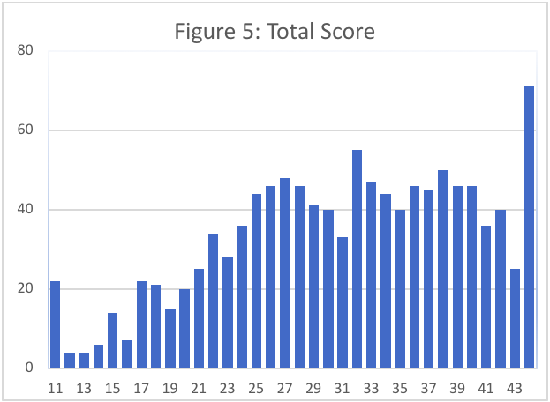
Distribution of the Total Score
Notes:
This shows the distribution of the 11 item total scores (sum of the 11 items). Note that it is reasonably normally distributed with a mean of 32. More importantly it shows that the scale spreads the scores across the entire range from 11 to 44.

Slide 95
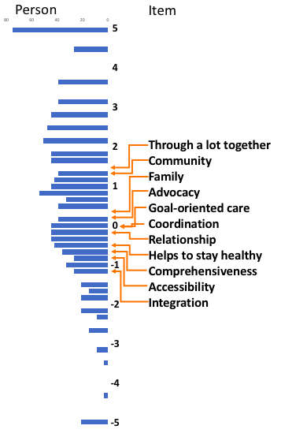
Rasch Model
Notes:
In the Rasch person-item map., on the left are the scores for the 1140 persons responding.
High scores are to the top and low scores to the bottom of the graph
On the right are the Rasch standardized scores for the 11 items. Items on each row are statistically different from items on the other rows.
Hard to endorse items are to the top and easy items are to the bottom of the
graph. The item numbers listed are the actual recoded items on the survey. So the two most difficult items to endorse are items 11 and item 14 (My doctor and I have been through a lot together; The care I get in this practice uses knowledge of community. The penciled in item numbers renumbered the items from 1-11 rather than from 6-16, mostly for my benefit.
Yes, the now horizontal axis is to be read as follows. For items, from "left to right" represents, on the left, easy to answer items (negative scored items are the easiest to answer) and on the right,
high positive items are the hardest to endorse. For the patient scores it's the same. Scores on the left, especially negative scores, are low scores and scores on the right, positive ones, are high scores. The # represent 6 subjects and the . represents from 1-5 subjects. Note on the extreme left of the slide the legend indicates what the marks mean.
Note also there are three capital letters on the graph (M,S, T). These stand for the Mean; S =1 SD and T = 2 SD. Note both patient scores and item scores are on the same standardized scale. The mean of the items is always set to zero. So you can see how many items and patient scores are above and below their respective means. Since the mean of the patient scores is higher than the mean of the items it means that, on average, the patients had a more positive response than the item difficulty level, in other words, the items were easier to endorse than the average item difficulty level. Rasch item developers often strive to have the mean person and mean item levels close together. Finally, note the person scores distribution looks reasonably normal which corresponds to the actual bar chart you will show. It's harder to see this distribution when # represents 6 patients but the Rasch people use this # to save space in showing the person-item maps.

Slide 96
Higher Score if Patients Agreed with these 2 questions
Do you have a single doctor or practice that you would say handles most of your care?
  N Mean SD (p<.001)
  Yes 907 32.3 7.9
  No 191 25.9 9.2
If your doctor or practice received the answers to these questions, would it help them to understand how you feel about your care?
  N Mean SD (p<.001)
  Yes 670 33.0 7.9
  No 428 28.3 8.5
Notes:
In summary, the evidence from three independent analyses of the data
(factor analysis, reliability analysis and Rasch analysis) show that a
single factor explains the associations among the 11 items and that as
a composite score it is reliable (0.94) and shows evidence of
concurrent validity with important patient health related items.

Slide 97
Association with Total Score
Was the survey hard to complete?
  N Mean SD (p<.02)
  Yes 41 28.1 9.5
  No 1057 31.3 8.4

Slide 98
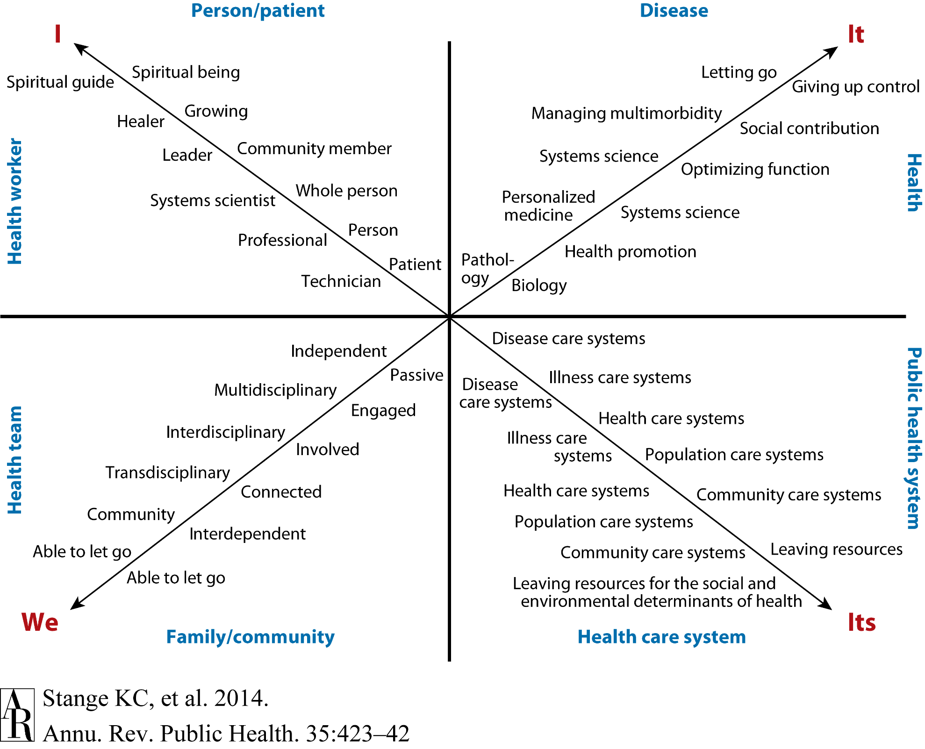

Slide 99
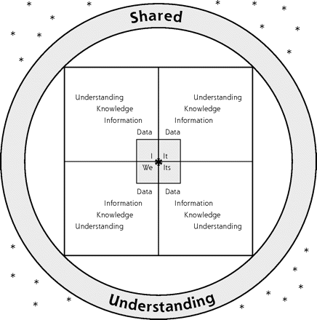
Ways of Knowing, Learning & Developing
Stange KC. Ways of knowing, learning, and developing. Ann. Fam. Med. Jan-Feb 2010;8(1):4-10

Slide 100
Health Care Systems Focused on Primary Care
Better population health
Lower cost
Less inequality
Better health care quality
Donaldson MS, Yordy KD, Lohr KN, Vanselow NA, eds. Primary Care: America's Health in a New Era. Washington D.C.: National Academy Press; 1996.
Starfield B, Shi LY, Macinko J. Contribution of primary care to health systems and health. Milbank Q. 2005;83(3):457-502.
Baicker K, Chandra A. Medicare spending, the physician workforce, and beneficiaries’ quality of care. Health Affairs W4-185 - W4-197, 2004.
Stange KC, Ferrer RL. The paradox of primary care. Ann Fam Med. 2009;7:293-299.

Slide 101
International Comparisons
Primary care orientation
  Health care system characteristics
  Practice characteristics
Health status and cost
  Rank on a composite of 14 health indicators
  Rank on per capita health care spending
Starfield B. Primary Care. Balancing Health Needs, Services and Technology. New York: Oxford University Press, 1998.

Slide 102
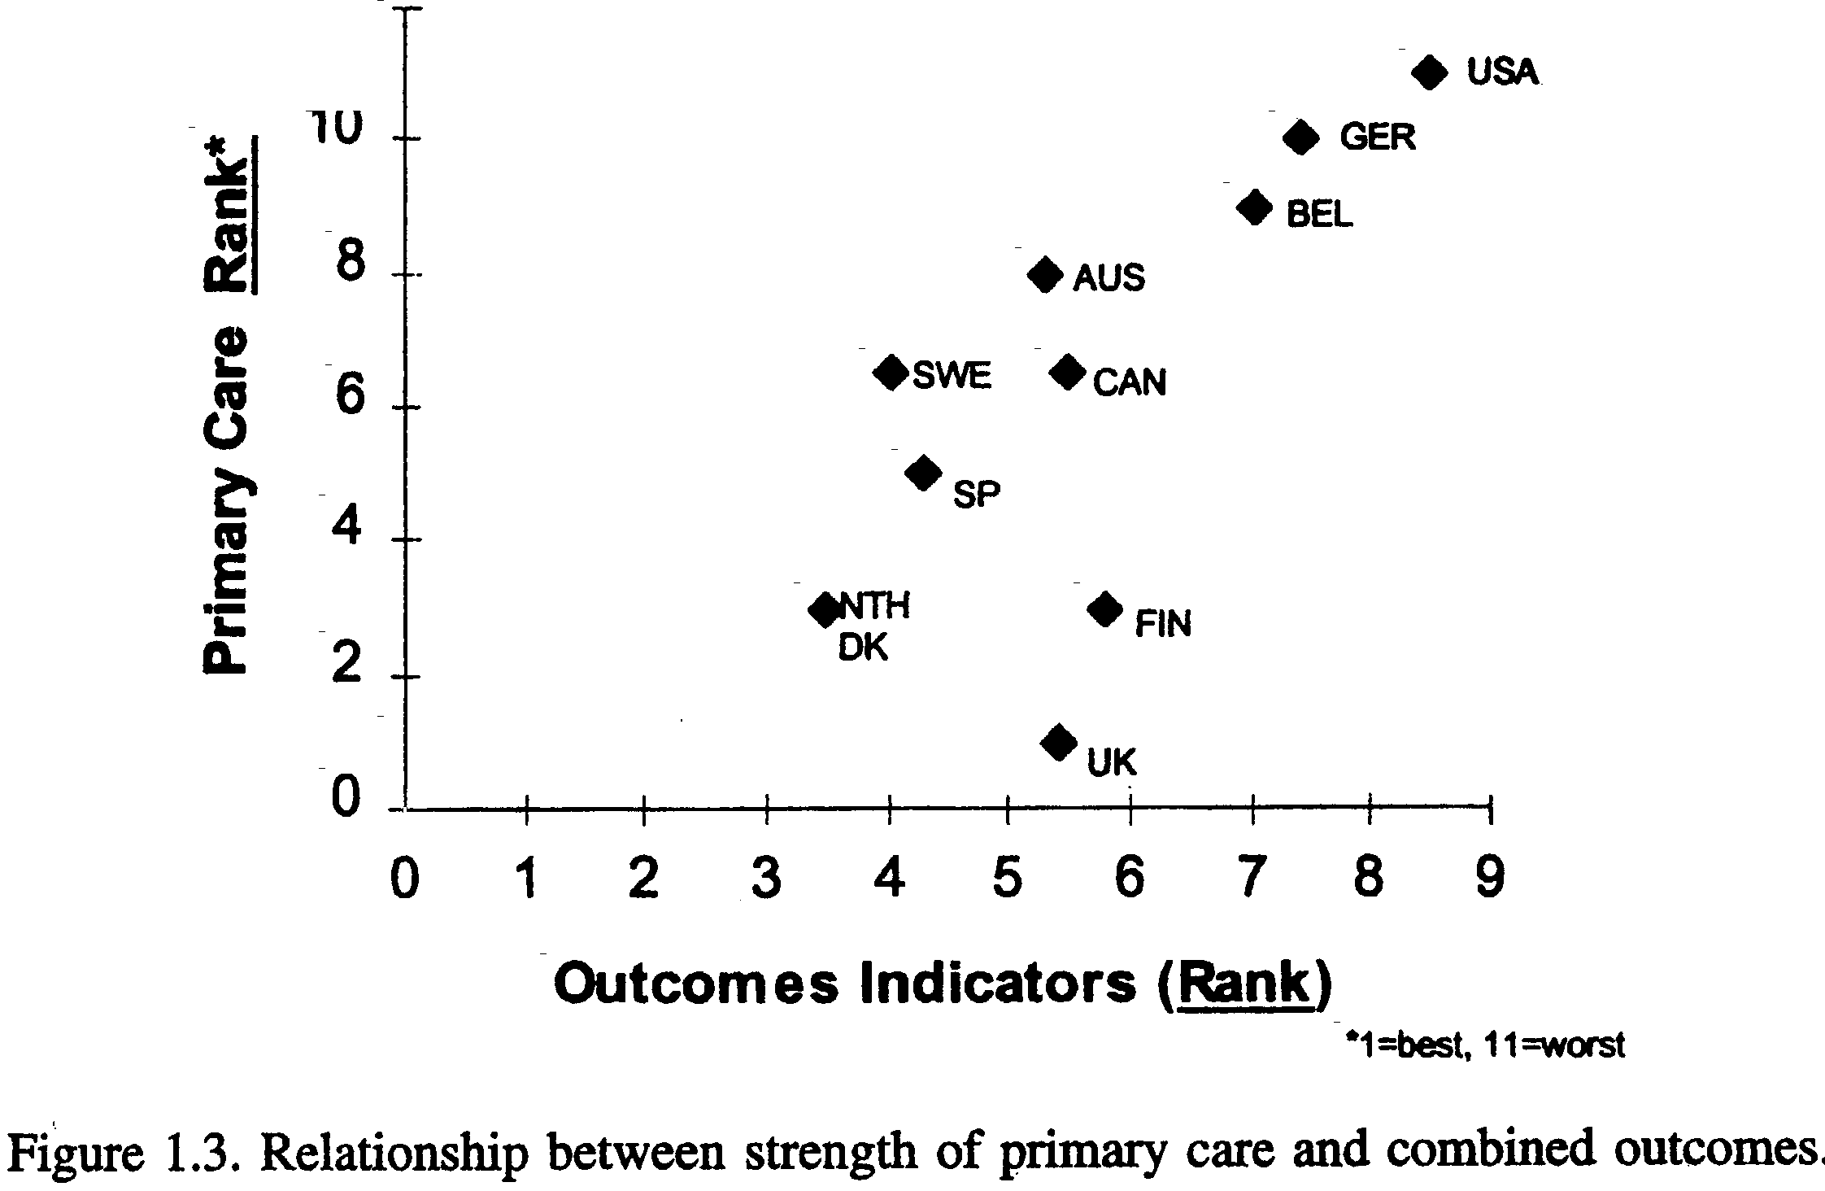
Primary Care and Health Outcomes
Source: Starfield B. Primary Care. Balancing health needs, services, and technology. New York: Oxford University Press, 1998.

Slide 103
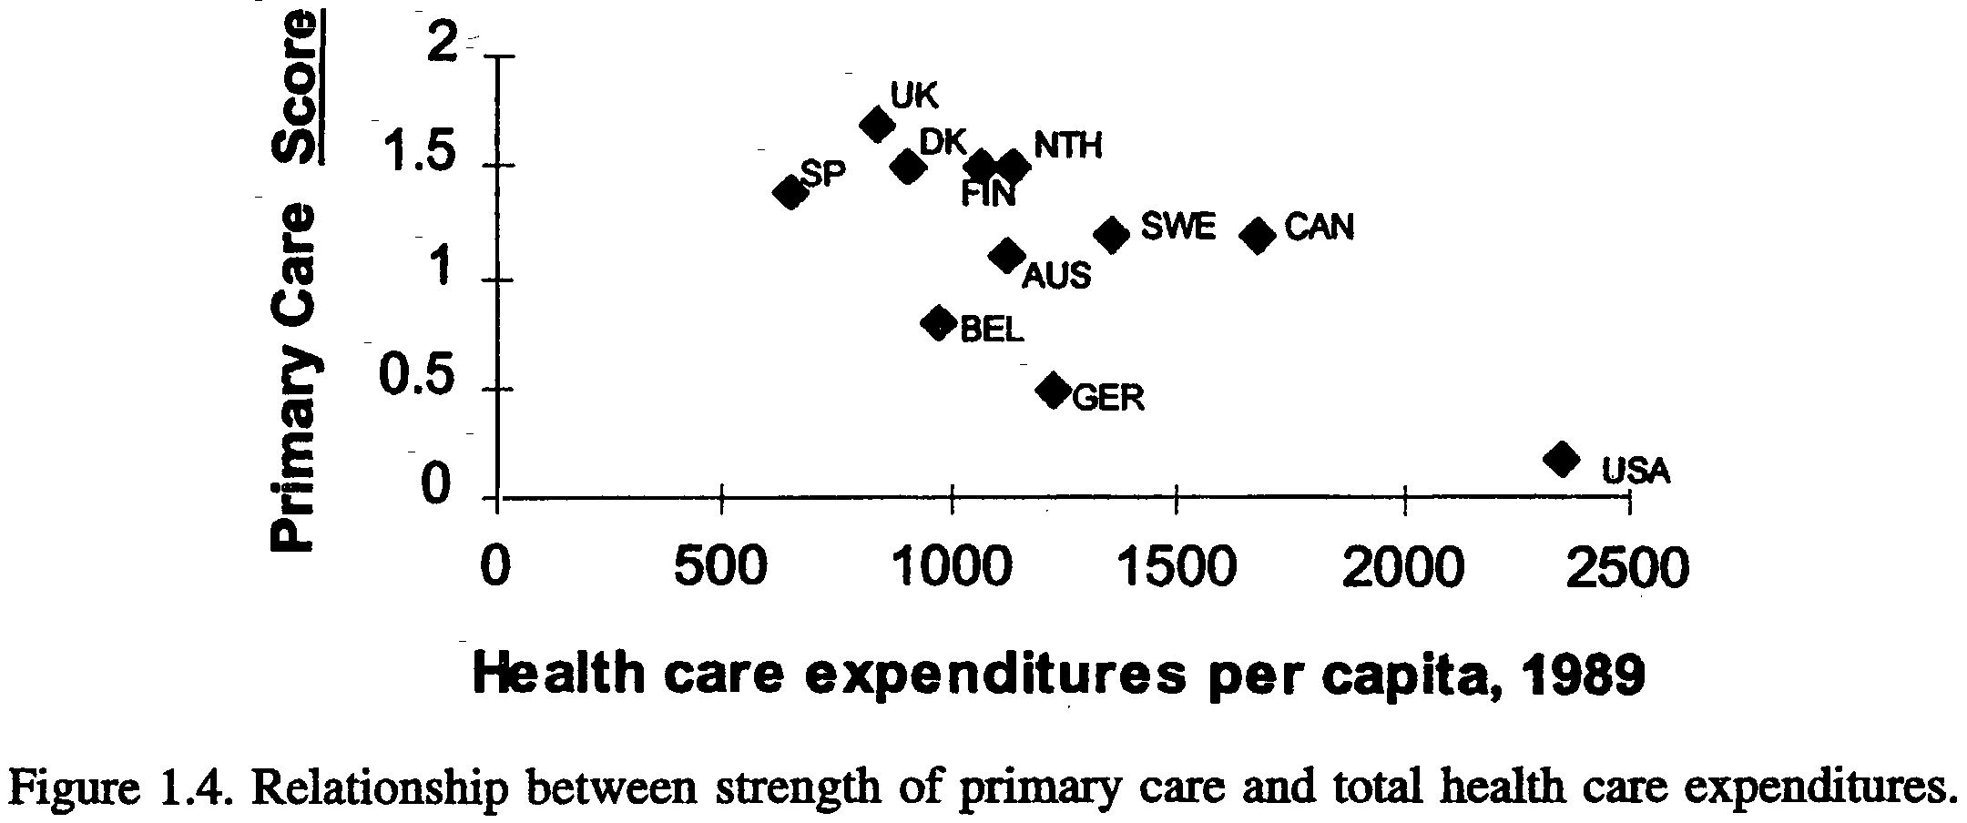
Primary Care and Health Care Expenditures
Source: Starfield B. Primary Care. Balancing health needs, services, and technology. Oxford, New York, 1998.

Slide 104
US Primary Care Physician Supply
Review of 10 studies of primary care & health
Improved all-cause, cancer, heart disease, stroke & infant mortality; low birth weight; life expectancy; and self-rated health
All-cause mortality
  ↑ of 1 primary care physician /10,000 population
  → 5.3% or 49 per 100,000 / yr ↓ mortality
  Macinko J, Starfield B, Shi L. Quantifying the health benefits of primary care physician supply in the United States. Int J Health Serv. 2007;37:111-26.

Slide 105
Inter-State Comparisons
Adjusted Medicare spending
  State-specific cost of living adjustment
  Age, sex, race of Medicare population
Quality measures
  24 Medicare Quality Improvement Organization measures
  6 common medical conditions
    MI
    Breast Cancer
    Diabetes
    Heart Failure
    Pneumonia
    Stroke
Baicker K, Chandra A. Medicare spending, the physician workforce, and beneficiaries’ quality of care. Health Affairs W4-185 - W4-197, 2004.

Slide 106
Baicker K, Chandra A. Medicare spending, the physician workforce, and beneficiaries’ quality of care. Health Affairs W4-185 - W4-197, 2004.

Slide 107
Baicker K, Chandra A. Medicare spending, the physician workforce, and beneficiaries’ quality of care. Health Affairs W4-185 - W4-197, 2004.

Slide 108
Starfield’s Summary
Countries with strong primary care
  Have lower overall costs
  Generally have healthier populations
Within countries
  Areas with higher primary care physician availability (but not specialist availability) have healthier populations
  Greater primary care physician availability reduces the adverse effects of social inequality
Starfield B. New paradigms for quality in primary care. Br J Gen Pract 51:303-309, 2001.
Macinko J, Starfield B, Shi L. Quantifying the health benefits of primary care physician supply in the United States. Int J Health Serv. 2007;37:111-26.
Starfield B, Shi LY, Macinko J. Contribution of primary care to health systems and health. Milbank Q. 2005;83(3):457-502

Slide 109
Emerging Models of Primary Care
Many on-the-ground practice innovations
Patient/person empowerment
Technology-amplified
Policy innovations that interact with primary care
Foundation of a integrated health care system
Community health centers
Focused on special populations
By groups, corporations e.g. Amazon, Berkshire Hathaway, JPMorgan Venture
PCMH
Hot-spotting
Direct primary care
McPhee J. Heirs of General Practice. New York, NY: Collins Publishers; 1986.
Stephens GG. Family medicine as counterculture. Fam Med. 1989;21(2):103-109.
DeVoe JE, et al. The Personal Doctoring Manifesto: A Perspective from the Keystone IV Conference. JABFM. 2016;29:(Supplement 1):S64-S68.

Slide 110
PCMH Evaluations
Increased quality
Decreased ED visits & hospitalizations for ambulatory-sensitive conditions
Cost reduction
Variable effects in different contexts
PCPCC. Results and Evidence: Research that demonstrates the medical home's cost and quality impact https://www.pcpcc.org/results-evidence .
Shi L, Lee DC, Chung M, Liang H, Lock D, Sripipatana A. Patient-Centered Medical Home Recognition and Clinical Performance in U.S. Community Health Centers. Health Serv Res. 2016 Jun 20. doi: 10.1111/1475-6773.12523. [Epub ahead of print]
Rhodes KV, Basseyn S, Gallop R, Noll E, Rothbard A, Crits-Christoph P. Pennsylvania's Medical Home Initiative: Reductions in Healthcare Utilization and Cost Among Medicaid Patients with Medical and Psychiatric Comorbidities. J Gen Intern Med. 2017 Jun 25. [Epub ahead of print] PubMed PMID: 27353455.
Cuellar A, Helmchen LA, Gimm G, Want J, Burla S, Kells BJ, Kicinger I, Nichols LM. The CareFirst Patient-Centered Medical Home Program: Cost and Utilization Effects in Its First Three Years. J Gen Intern Med. 2016 Jul 29. [Epub ahead of print] PubMed PMID: 27473005.

Slide 111
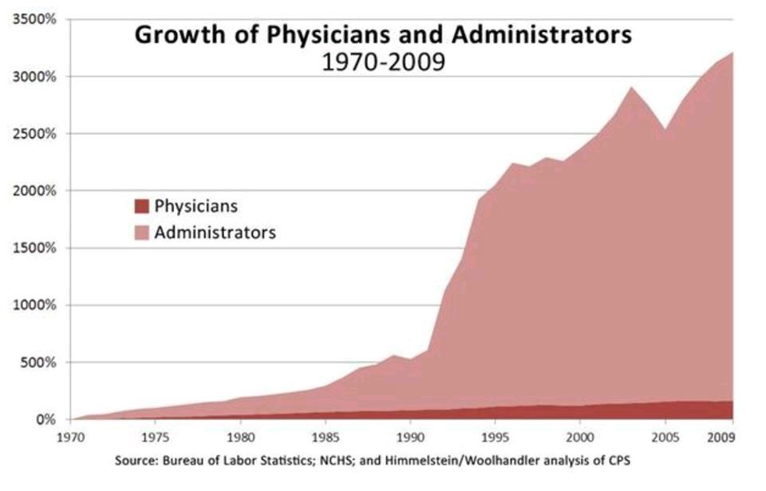
http://www.nejm.org/doi/pdf/10.1056/NEJM199105023241805
Presented by Julie Gunther at the 2016 DPC Summit.

Slide 112
Direct Primary Care
Patients pay a monthly, quarterly, or annual fee that covers all or most primary care services
Often combined with high deductable insurance
Results
  More time with patients
  Low overhead; no insurance filing
Direct Primary Care Coalition. www.dpcare.org
Wu WN, Bliss G, Bliss EB, Green LA. Practice profile. A direct primary care medical home: the Qliance experience. Health Aff (Millwood). 2010 May;29(5):959-62. http://content.healthaffairs.org/content/29/5/959.full

Slide 113
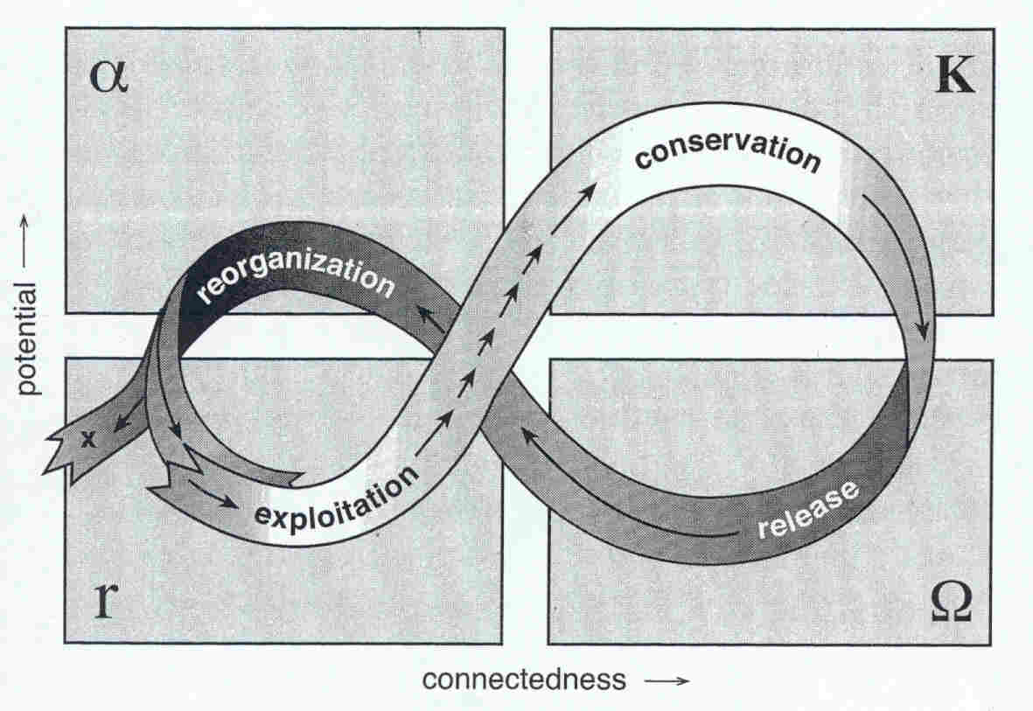
How Change Happens in Systems
Gunderson LH, Holling CS, eds. Panarchy: understanding transformations in human and natural systems. Washington, DC: Island Press; 2002.
Stange KC. Making sense of health care transformation as adaptive-renewal cycles. Ann Fam Med, 2009; 7: 484-487.
Notes:
A Panarchy framework shows how ecological / social / economic systems change in non-linear ways over time.
2 dimensions:
POTENTIAL, CONNECTEDNESS
The cycle goes between an EXPLOITATION phase of rapid growth into a newly disturbed and fertile environment, (an entrepreneurial market where the first to the prize wins) and a
CONSERVATION phase of slower growth and specialization (a bureaucratic hierarchy)
RELEASE phase of CREATIVE DESTRUCTION in which the accumulation of tightly bound resources becomes increasingly fragile and potential energy is released by sudden events.
A final phase of REORGANIZATION in which depleted resources become available for the next phase of exploitation. Part of this reorganization involves the transient appearance or expansion of pioneer organisms that begin to capture opportunity. (innovation and restructuring)

Slide 114
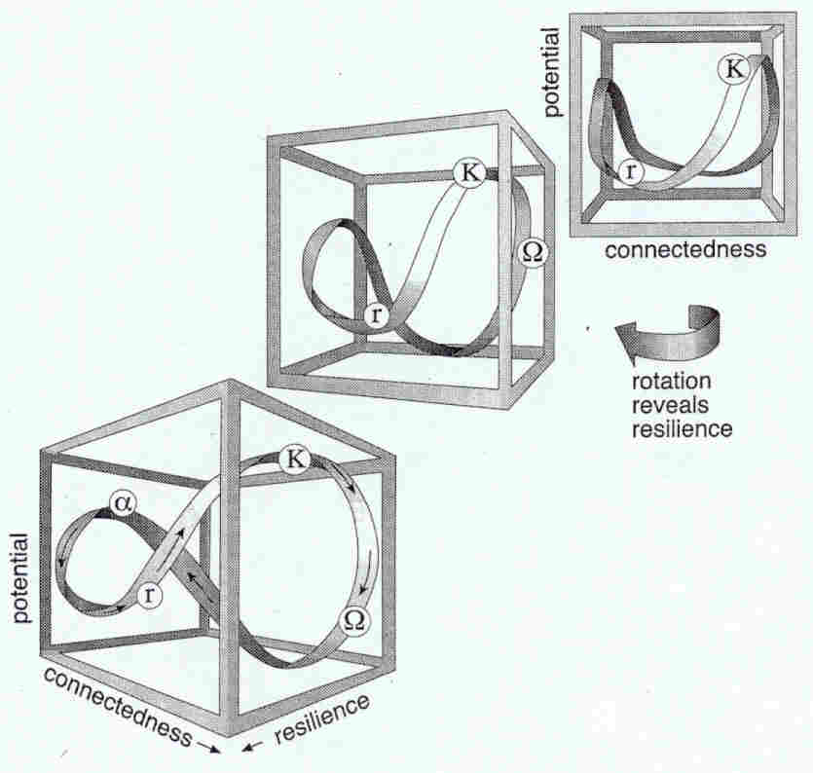
Resilience
Notes:
The 3rd dimension, RESILIENCE varies through the cycle.
Resilience shrinks as the cycle moves toward the conservation phase (K), where the system becomes more brittle.
Resilience expands as the cycle shifts rapidly into a “back loop” to reorganize accumulated resources for a new initiation of the cycle.

Slide 115
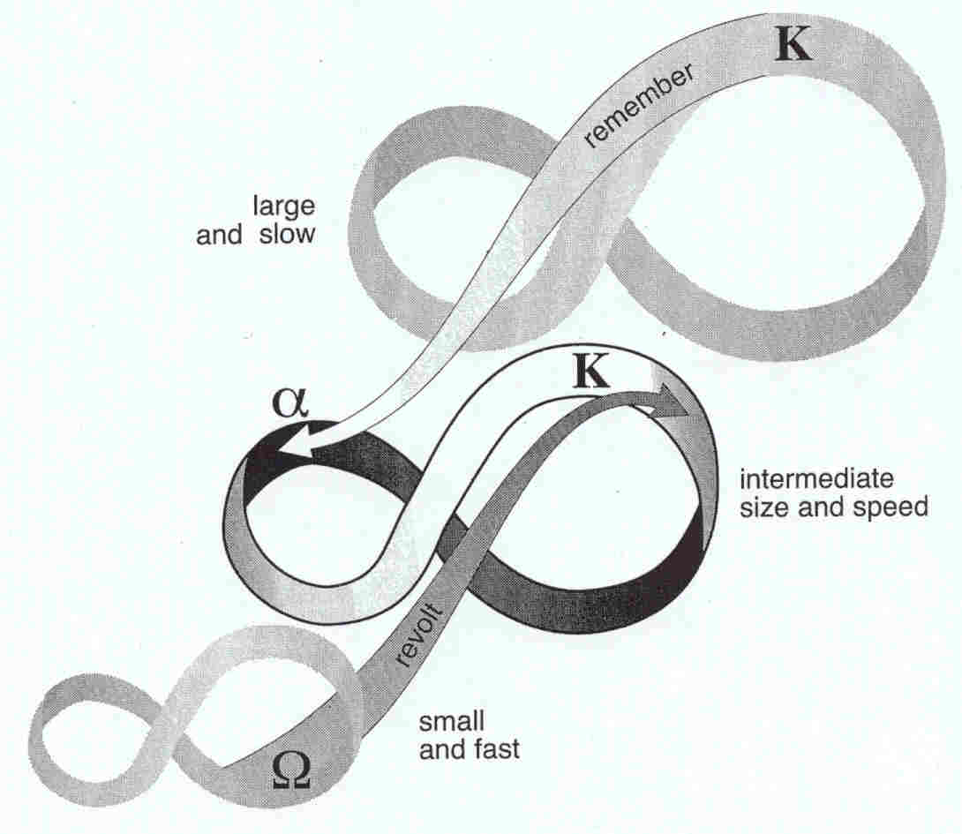
Connections between system levels
Notes:
Multiple pararchies operate at different rates and are connected:
Two important types of connections are:
REVOLT connections in which a critical change in one cycle cascades up to a vulnerable stage in a larger and slower one.
A REMEMBER connection which facilitates renewal by drawing on the potential that has been accumulated in a larger, slower cycle.

Slide 116
Adaptive Cycles
Notes:
2 dimensions:
POTENTIAL, CONNECTEDNESS
The cycle goes between an EXPLOITATION phase of rapid growth into a newly disturbed and fertile environment, (an entrepreneurial market where the first to the prize wins) and a
CONSERVATION phase of slower growth and specialization (a bureaucratic hierarchy)
RELEASE phase of CREATIVE DESTRUCTION in which the accumulation of tightly bound resources becomes increasingly fragile and potential energy is released by sudden events.
A final phase of REORGANIZATION in which depleted resources become available for the next phase of exploitation. Part of this reorganization involves the transient appearance or expansion of pioneer organisms that begin to capture opportunity. (innovation and restructuring)

Slide 117
Implied Strategies
Consider where we are in our cycle
Remember and build on our roots as healers
  In a rapidly changing environment, a generalist approach is adaptive
  Relationships AND (information) technology
Work to survive in the last stage of the conservation phase while planting seeds for the release/reorganization phase (Set up success in the exploitation phase)
Consider multiple fast & slow cycles
  System change
  Practice transformation
  Information age
  Demographic and political shifts
  Economies: local, country, world

Slide 118
Problem of Fragmentation

Slide 119
US Health Care
“Fundamentally flawed” *
Most expensive in the world**
37th in the health of our people**
More integrated systems provide greater value***
* Institute of Medicine. Crossing the quality chasm: A new health system for the 21st century. Washington, DC: National Academy Press; 2001.
** WHO. Press Release WHO/44: World Health Organization assesses the world's health systems. World Health Organization, Geneva Switzerland. http://www.who.int/inf-pr-2000/en/pr2000-44.html.
*** Starfield B, Shi LY, Macinko J. Contribution of primary care to health systems and health. Milbank Quarterly. 2005;83(3):457-502.

Slide 120
Fragmentation
Focusing on the parts without appreciating their relation to the whole
Limited understanding of how the components of health and disease processes and health care work together
Leads to
  Uncontextualized investigation
  Fragmentation of care
  Devaluing of health care’s higher order functions and possibilities.
Engel, GL. The need for a new medical model. Science 1977;196:129–136.
Stange KC. The paradox of the parts and the whole in understanding and improving general practice. Int J Qual Health Care, 2002; 14(4):267-268.
Stange KC. The problem of fragmentation and the need for integrative solutions. Ann. Fam. Med. 2009;7(3):100-103.

Slide 121
Consequences of Fragmented Approach to Healthcare
Inefficiency & ineffectiveness
Inequality
Commoditization
Commercialization
Deprofessionalization
Depersonalization
Despair & discord
Stange KC. The problem of fragmentation and the need for integrative solutions. Ann. Fam. Med. 2009;7(3):100-103.

Slide 122
Misunderstanding what is important about (primary) health care
How it is misunderstood
  Simple
  Commodity
  If we get the parts right (care of individual diseases), the whole (person) will be better
Consequences
  Fragmentation
  Depersonalization
  Ineffectiveness, inefficiency
Engel, GL. The need for a new medical model. Science 1977;196:129–136.
Stange KC. The paradox of the parts and the whole in understanding and improving general practice. Int J Qual Health Care, 2002; 14(4):267-268.
Stange KC. The problem of fragmentation and the need for integrative solutions. Ann. Fam. Med. 2009;7(3):100-103.
Stange KC, Etz RS, Gullett H, et al. Metrics for assessing improvements in primary health care. Annu Rev Public Health. 2014;35:423-442.

Slide 123
Robert May, President of the Royal Society
“Application of the physical and biological sciences has made today arguably the best of times… But the unintended consequences of these well-intentioned actions…could well make tomorrow the worst of times.
The significant breakthrough we really need is better understanding of human institutions, particularly of the impediments to collective, cooperative activity in which all individuals pay small costs to reap large group benefits. Darwin recognised the evolution of cooperative behaviour as one of the most important unsolved problems of his day. We have made relatively little progress since then. Perhaps the social scientists of 2056 will have succeeded in combining the rigour of the "hard" (that is, easy) sciences with the thoughtful introspection of the humanities to solve this problem. I certainly hope so.”
18 November 2006, NewScientist.com news service.
Notes:
Application of the physical and biological sciences has made today arguably the best of times: we live longer and healthier lives, food production has doubled in the past 35 years and energy subsidies have substituted for human labour, washing away hierarchies of servitude. But the unintended consequences of these well-intentioned actions - climate change, biodiversity loss, inadequate water supplies, and much else - could well make tomorrow the worst of times.
The significant breakthrough we really need is better understanding of human institutions, particularly of the impediments to collective, cooperative activity in which all individuals pay small costs to reap large group benefits. Darwin recognised the evolution of cooperative behaviour as one of the most important unsolved problems of his day. We have made relatively little progress since then. Perhaps the social scientists of 2056 will have succeeded in combining the rigour of the "hard" (that is, easy) sciences with the thoughtful introspection of the humanities to solve this problem. I certainly hope so.
Robert May, President of the Royal Society, 18 November 2006
NewScientist.com news service

Slide 124
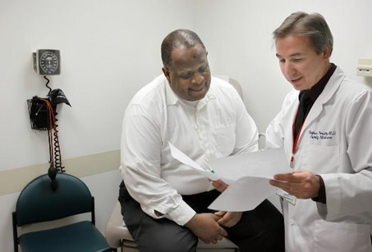
Principles of Primary Care
Accesibility as 1st contact with health care
Accountability for large majority of healthcare needs (comprehensiveness)
Coordination & integration of care across settings, acute & chronic illnesses, mental health & prevention
Sustained partnership – relationships over time in a family & community context
Starfield B. Primary Care. Balancing Health Needs, Services and Technology. New York: Oxford University Press, 1998.
Donaldson MS, Yordy KD, Lohr KN, Vanselow NA, eds. Primary Care: America's Health in a New Era. Washington D.C.: National Academy Press; 1996.
Stange KC, Nutting PA, Miller WL, et al. Defining and measuring the Patient-Centered Medical Home. J Gen Intern Med. 2010; 25(6): 601-612.
124

Slide 125

A Science of Connectedness www.AnnFamMed.org
The problem of fragmentation Mar 2009, v7i2
A generalist approach May 2009, v7i3
The paradox of primary care Jul 2009, v7i4
A science of connectedness Sept 2009, v7i5
Cycles of renewal & adaption Nov 2009, v7i6
Ways of knowing and inquiry Jan 2010, v8i1
Regaining our moral authority Mar 2010, v8i2
www.annfammed.org/cgi/collection/editorial_series
Notes:
The problem of fragmentation that underlies the more obvious health care crises
A generalist solution – to reducing fragmentation and fostering integration
A science of connectedness – an image of complex ongoing co-adaptation
Learning organizations – how to embed ongoing learning and change in health care organizations
Different approaches to inquiry – a set of practical inquiries that can facilitate ongoing service improvements in learning organizations
Cycles of Renewal & Adaption – that identify useful strategies for the current unstable position in the health care cycle.
Regaining our moral authority – I am considering adding a challenging 7th and final piece that calls for action based on understanding the iron triangle created by moral authority (as sacrifice), power (as defined by Howard Brody) and a righteous cause (in our case, improving health, as defined by the WHO).

Slide 126
Accessing Series Online
www.AnnFamMed.org
  Article Collections (from options on the right)
  Under: Core values of primary care:
  Science of connectedness / practice of generalism (7 Articles)
Or: www.annfammed.org/cgi/collection/editorial_series

Slide 127
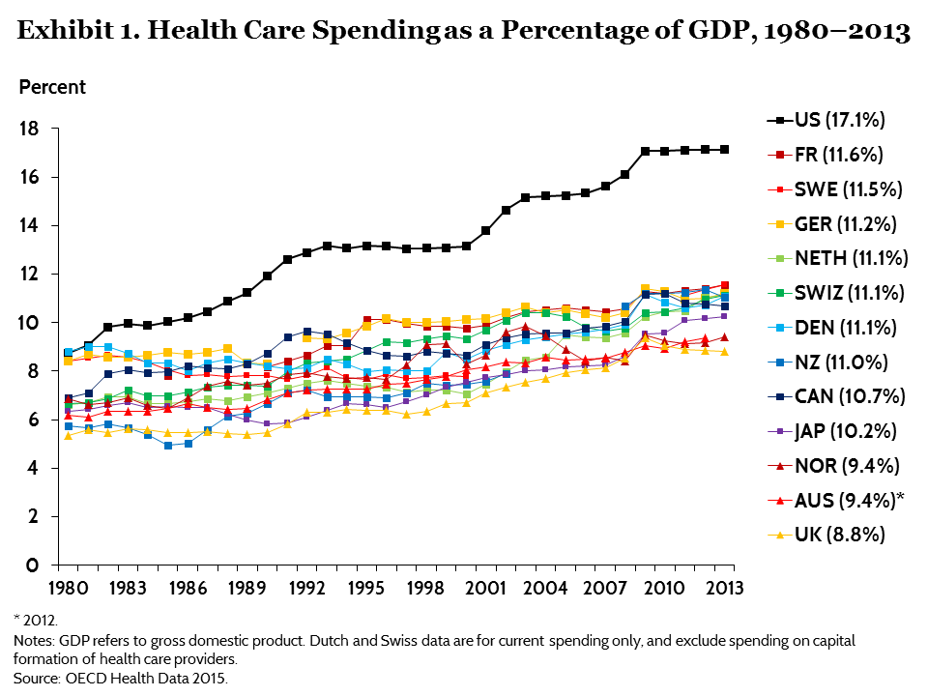
Health Care Spending
www.commonwealthfund.org/publications/issue-briefs/2015/oct/us-health-care-from-a-global-perspective

Slide 128
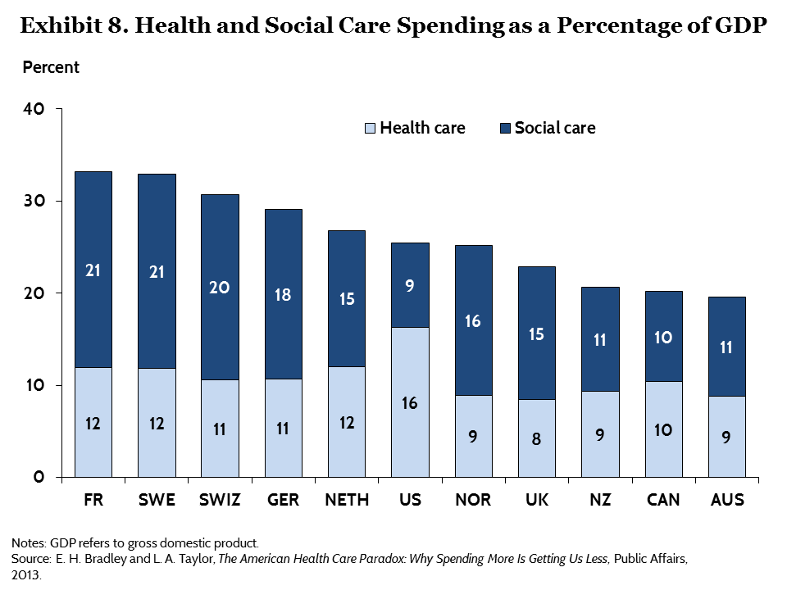
www.commonwealthfund.org/publications/issue-briefs/2015/oct/us-health-care-from-a-global-perspective

Slide 129
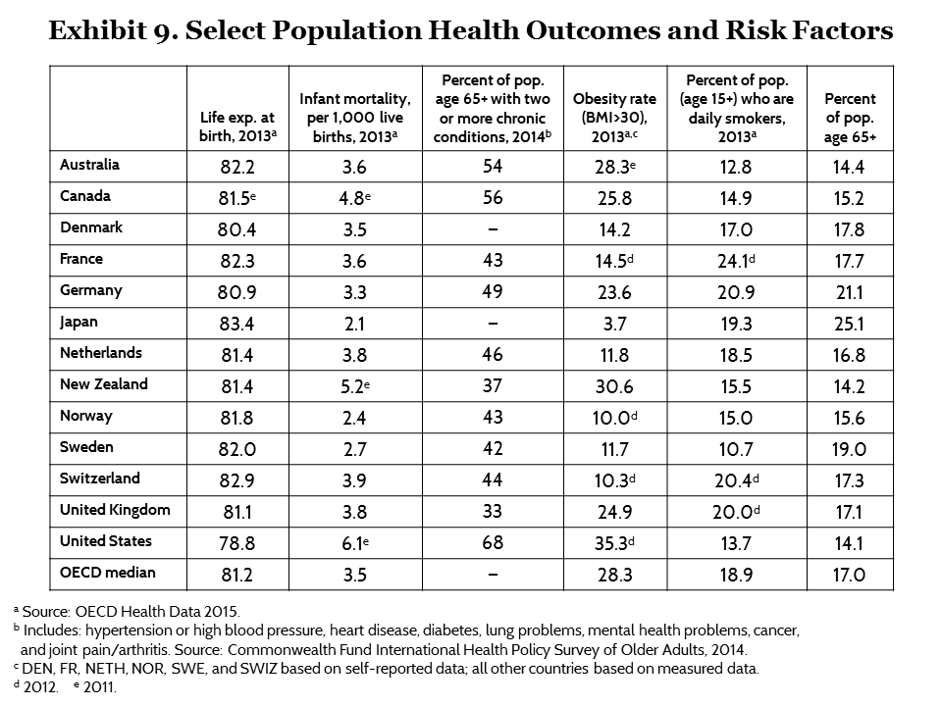
www.commonwealthfund.org/publications/issue-briefs/2015/oct/us-health-care-from-a-global-perspective

Slide 130
Mirror, Mirror on the Wall, 2014 Update: How the U.S. Health Care System Compares Internationally
www.commonwealthfund.org/publications/fund-reports/2014/jun/mirror-mirror
Notes:
130

Slide 131
Key Provisions of the Affordable Care Act
Individual mandate
Employer mandate
Pre-existing condition protection
Essential health benefits
Qualified health plans / coverage tiers
Medicaid expansion
Premium tax credits
Cost-sharing subsidies
Prevention and wellness programs
Fees and taxes
Grandfathered plans
CMS Innovation Center

Slide 132
Accountable Care Organizations
An ACO is a network of doctors and hospitals that shares responsibility for providing care to patients.
ACOs agree to manage all of the health care needs of a minimum of 5,000 Medicare or Medicaid beneficiaries for at least three years.
Fisher, E.S., et al., Fostering accountable health care: moving forward in Medicare. Health Aff (Millwood), 2009. 28(2): p. w219-31.
McClellan, M., et al., A national strategy to put accountable care into practice. Health Affairs, 2010. 29(5): p. 982-90.
Rittenhouse, D.R., S.M. Shortell, and E.S. Fisher, Primary care and accountable care -- two essential elements of delivery-system reform. N Engl J Med, 2009.

Slide 133
The Patient-Centered Medical Home
A political construct
Hundreds of demonstrations around the country
Movement toward changing
  Health care organization
  Reimbursement
Growing evidence of effectiveness
The Patient-Centered Primary Care Collaborative. www.pcpcc.net/index.php.
Patient Centered Primary Care Collaborative. A Miracle of Modern Medicine. 2009. www.pcpcc.net/content/primary-care-miracle-modern-medicine.
Patient Centered Primary Care Collaborative. 2009 PCPP Pilot Guide: Proof in Practice. A Compilation of Patient Centered Medical Home Pilot and Demonstration Projects. 2009:90. www.pcpcc.net/pilot-guide. Robert Graham Center. The PCMH: History, seven core features, evidence and transformational change. Washington, DC; 2007. www.graham-center.org/online/graham/home/publications/monographs-books/2007/rgcmo-medical-home.html
Stange KC, Miller WL, Nutting PA, Crabtree BF, Stewart EE, Jaén CR. Context for understanding the National Demonstration Project and the Patient-Centered Medical Home. Ann Fam Med. 2010;8(Suppl 1):S2-S8. www.annfammed.org/cgi/content/full/8/Suppl_1/S2

Slide 134
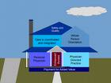

Joint Principles of the PCMH
Personal physician
Physician-directed medical practice
Whole person orientation
Care is coordinated and integrated
Quality & safety
Enhanced access
Payment recognizes added value
AAFP, AAP, ACP, AOA. Joint principles of the patient-centered medical home. 2007; www.medicalhomeinfo.org/Joint%20Statement.pdf.

Slide 135
The PCMH is
1) The fundamental tenets of primary care:
  First contact access
  A comprehensive, whole person approach
  Integration & coordination of care
  Relationships involving sustained partnership
2) New ways of organizing practice
3) Development of practices’ internal capabilities
4) Health care system & reimbursement changes.
Stange KC, Nutting PA, Miller WL, et al. Defining and measuring the patient-centered medical home. J. Gen. Intern. Med. 2010;25(6):601-612.

Slide 136
What’s happening between the lines
Lurching movement toward value-based payment (paying for value vs. volume)
Consolidation
Commodification
Demographic & behavioral imperatives
Venture capital
Vilification of the commons / collective

Slide 137
The Paradox of Primary Care
Stange KC. The paradox of primary care. Ann. Fam. Med. 2009;7(4):100-103.

Slide 138
Primary Care
Problem?
Solution?

Slide 139
Primary care is a problem
Disease-by-disease
Poor quality of care

Slide 140
Specialty vs Primary Care
Specialists more knowledgeable about conditions in their specialty.
Specialists more likely to use medications associated with improved survival and to comply with screening guidelines.
Specialists use more tests, procedures and hospital time.
Harrold LR, Field TS, Gurwitz JH. Knowledge, patterns of care, and outcomes of care for generalists and specialists. J Gen Intern Med. 1999; 14:499-511.

Slide 141
Measures of process of care tend to favor specialists for:
  Myocardial infarction
  Other cardiovascular diseases
  Acute non-hemorrhagic stroke
  Asthma
  Arthritis
  Psychiatric diseases
  Skin diseases
  Preventive care
Harrold LR, Field TS, Gurwitz JH. Knowledge, patterns of care, and outcomes of care for generalists and specialists. J Gen Intern Med. 1999; 14:499-511.

Slide 142
‘Expert Generalists’ vs. Specialists
Similar proportion of HIV+ patient on HAART
Non-expert generalists
  Low volume of HIV+ patients
  Much less likely to use recommended HIV Rx
  Landon BE, Wilson IB, Cohn SE et al. Physician specialization and antiretroviral therapy for HIV. J Gen Intern Med. 2003; 18:233-241.

Slide 143
Shared Care
In observational studies, more guideline-concordant care if shared between:
Primary care physician AND endocrinologist (diabetes and general preventive care)
Primary care physician an AND cardiologist (acute M.I.; CHF [also lower 30-day readmission])
Lafata JE, Martin S, Morlock R, Divine G, Xi H. Provider type and the receipt of general and diabetes-related preventive health services among patients with diabetes. Med Care. 2001; 39:491-499.
Willison DJ, Soumerai SB, McLaughlin TJ, et al. Consultation between cardiologists and generalists in the management of acute myocardioal infarction: implications for quality of care. Arch Intern Med. 1998; 158:1778-1783.
Ahmed A, Allman RM, Kiefe CI, et al. Association of consultation between generalists and cardiologists with quality and outcomes of heart failure care. Am Heart J. 2003; 145:1086-1093.

Slide 144
Shared Care
In RCT of depressed patients:
Primary care physician AND psychiatrist
Greater adherence, recovery, satisfaction
Katon W, VonKorff M, Lin E, et al. Stepped collaborative care for primary care patients with persistent symptoms of depression: a randomized trial. Arch Gen Psychiatry. 1999; 56:1109-1115.

Slide 145
Current Efforts to Improve Quality of Care
Increase access to specialty care
Carve outs
Disease management programs
Disease-specific pay-for-performance
Brook RH, McGlynn EA, Cleary PD. Quality of health care: Part 2: Measuring quality of care. N Engl J Med. 1996;335:966-969.
Stange KC. The paradox of the parts and the whole in understanding and improving general practice. Int J Qual Health Care, 2002; 14(4):267-268.
Aron D, Pogach L. Specialists versus generalists in the era of pay for performance: “A plague o’ both your houses!” Qual Saf Health Care. 2007;16:3-5.

Slide 146
Primary care is a solution
Whole-person functional health
Cost
Population health

Slide 147
Medical Outcomes Study
Patients with hypertension and diabetes
3 follow-up points over 7 years
Compared primary vs. specialty care
Outcomes (controlling for patient mix)
  Physical & emotional (functional) health
  Mortality
  Disease-specific physiologic markers
Greenfield S, Nelson EC, Zubkoff M, et al. Variations in resource utilization among medical specialties and systems of care: results from the Medical Outcomes Study. JAMA. 1992; 267:1624-1630.
Greenfield S, Rogers W, Mangotich M, Carney MF, Tarlov AR. Outcomes of patients with hypertension and non-insulin-dependent diabetes mellitus treated by different systems and specialties. Results from the Medical Outcomes Study. JAMA. 1995; 274:1436-1444.

Slide 148
Medical Outcomes Study
Similar outcomes for primary & specialty care
  Physical & emotional (functional) health
  Mortality
  Disease-specific physiologic markers
Lower resource use & cost for primary care
  Tests, procedures
  Drugs
  Office visits, hospitalizations
Greenfield S, Nelson EC, Zubkoff M, et al. Variations in resource utilization among medical specialties and systems of care: results from the Medical Outcomes Study. JAMA. 1992; 267:1624-1630.
Greenfield S, Rogers W, Mangotich M, Carney MF, Tarlov AR. Outcomes of patients with hypertension and non-insulin-dependent diabetes mellitus treated by different systems and specialties. Results from the Medical Outcomes Study. JAMA. 1995; 274:1436-1444.

Slide 149
International Comparisons
Primary care orientation
  Health care system characteristics
  Practice characteristics
Health status and cost
  Rank on a composite of 14 health indicators
  Rank on per capita health care spending
Starfield B. Primary Care. Balancing Health Needs, Services and Technology. New York: Oxford University Press, 1998.

Slide 150
Primary Care and Health Outcomes
Source: Starfield B. Primary Care. Balancing health needs, services, and technology. New York: Oxford University Press, 1998.

Slide 151
Primary Care and Health Care Expenditures
Source: Starfield B. Primary Care. Balancing health needs, services, and technology. Oxford, New York, 1998.

Slide 152
US Primary Care Physician Supply
Review of 10 studies of primary care & health
Improved all-cause, cancer, heart disease, stroke & infant mortality; low birth weight; life expectancy; and self-rated health
All-cause mortality
  ↑ of 1 primary care physician /10,000 population
  → 5.3% or 49 per 100,000 / yr ↓ mortality
  Macinko J, Starfield B, Shi L. Quantifying the health benefits of primary care physician supply in the United States. Int J Health Serv. 2007;37:111-26.

Slide 153
Inter-State Comparisons
Adjusted Medicare spending
  State-specific cost of living adjustment
  Age, sex, race of Medicare population
Quality measures
  24 Medicare Quality Improvement Organization measures
  6 common medical conditions
    MI
    Breast Cancer
    Diabetes
    Heart Failure
    Pneumonia
    Stroke
Baicker K, Chandra A. Medicare spending, the physician workforce, and beneficiaries’ quality of care. Health Affairs W4-185 - W4-197, 2004.

Slide 154
Baicker K, Chandra A. Medicare spending, the physician workforce, and beneficiaries’ quality of care. Health Affairs W4-185 - W4-197, 2004.

Slide 155
Baicker K, Chandra A. Medicare spending, the physician workforce, and beneficiaries’ quality of care. Health Affairs W4-185 - W4-197, 2004.

Slide 156
Starfield’s Summary
Countries with strong primary care
  Have lower overall costs
  Generally have healthier populations
Within countries
  Areas with higher primary care physician availability (but not specialist availability) have healthier populations
  Greater primary care physician availability reduces the adverse effects of social inequality
Starfield B. New paradigms for quality in primary care. Br J Gen Pract 51:303-309, 2001.
Macinko J, Starfield B, Shi L. Quantifying the health benefits of primary care physician supply in the United States. Int J Health Serv. 2007;37:111-26.
Starfield B, Shi LY, Macinko J. Contribution of primary care to health systems and health. Milbank Q. 2005;83(3):457-502

Slide 157
Paradox of Primary Care
Primary care is associated with:
Poor quality of care for individual diseases, but
Better quality at population level
Similar whole-person functional health
Better population health
Lower resource use and cost
Less inequality in healthcare & health
Stange KC. The paradox of primary care. Ann. Fam. Med. 2009;7(4):100-103.

Slide 158
The Problem with Not Understanding what is Important about Primary Care
How it is misunderstood
  Simple
  Commodity
  If we get the parts right (care of individual diseases), the whole (person) will be better
Consequences
  Fragmentation
  Depersonalization
  Ineffectiveness, inefficiency
Engel, GL. The need for a new medical model. Science 1977;196:129–136.
Stange KC. The paradox of the parts and the whole in understanding and improving general practice. Int J Qual Health Care, 2002; 14(4):267-268.
Stange KC. The problem of fragmentation and the need for integrative solutions. Ann. Fam. Med. 2009;7(3):100-103.

Slide 159
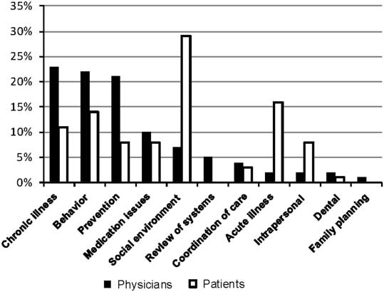
Domains of health issues initiated by clinician or patient
(n=365 total health issues at 15 encounters)
Bolen SD, Sage P, Perzynski AT, Stange KC. No Moment Wasted: The Primary Care Visit for Adults with Diabetes. Primary Healthcare Research & Development. 2015; May 20:1-15.

Slide 160
Practice Change Models

Slide 161
Cohen D, McDaniel RR, Crabtree BF, et al. A practice change model for quality improvement in primary care practice. J Healthc Manag, 2004; 49:155-170.
Notes:
The Practice Change Model is based on systems science.
It shows not just the important factors, but their interactions, and indicates co-evolution over time.

Slide 162
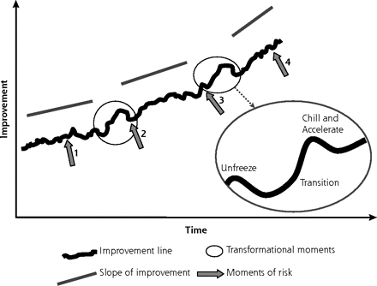
Developmental pathway of change and transformation
Miller WL, Crabtree BF, Nutting PA, Stange KC, Jaén CR. Primary care practice development: A relationship-centered approach. Ann Fam Med. 2010; 8 (Suppl 1): S68-S79.

Slide 163
Integrating Behavioral & Primary Care
Purpose of study
  Describe how different clinicians integrate care
  Identify important contextual factors
Methods
  Comparative case study by multidisciplinary team
  Observation, interviews, practice staff diaries
  Data from two studies
    Advancing Care Together – a demonstration project of 11 practices located in Colorado
    Integration Workforce Study - 8 practices across the US
Cohen DJ, Davis M, Balasubramanian BA, et al. Integrating Behavioral Health and Primary Care: Consulting, Coordinating and Collaborating Among Professionals. J Am Board Fam Med. 2015;28 Suppl 1:S21-31.
Cohen DJ, Balasubramanian BA, Davis M, et al. Understanding Care Integration from the Ground Up: Five Organizing Constructs that Shape Integrated Practices. J Am Board Fam Med. 2015;28 Suppl 1:S7-S20.
Notes:
Purpose: To describe how clinicians from different backgrounds interact to deliver
integrated behavioral and primary health care, and the contextual factors that shape
such interactions.
Methods: This was a comparative case study, in which a multidisciplinary team used an immersion-crystallization approach to analyze data from observations of practice
operations, interviews with practice members, and implementation diaries. The
observed practices were drawn from two studies: Advancing Care Together, a
demonstration project of 11 practices located in Colorado, and the Integration
Workforce Study, consisting of 8 practices located across the US.
Results: Primary care and behavioral health clinicians used three interpersonal
strategies to work together in integrated settings: consulting, coordinating, and
collaborating (3Cs). Consulting occurred when clinicians sought advice, validated care
plans, or corroborated perceptions of a patient’s needs with another professional.
Coordinating involved two professionals working in a parallel or back-and-forth fashion
to achieve a common patient care goal, while delivering care separately. Collaborating
involved two or more professionals interacting in real time to discuss a patient’s
presenting symptoms, describe their views on treatment, and jointly develop a care
plan. Collaborative behavior emerged when a patient’s care or situation was complex or
novel. We identified contextual factors shaping use of the 3Cs, including: time to plan
patient care, staffing, employing brief therapeutic approaches, proximity of clinical team
members, and electronic health record documenting behavior.
Conclusion: Primary care and behavioral health clinicians, thought their interaction,
consult, coordinate, and collaborate with each other to solve patients’ problems.
Organizations can create integrated care environments that support these
collaborations and health professions training programs should equip clinicians to
execute all three routinely in practice.

Slide 164
Integrating Behavioral & Primary Care
3 strategies for working together
  Consulting
  Coordinating
  Collaborating
Key contextual factors
  time to plan patient care
  Staffing
  employing brief therapeutic approaches
  proximity of clinical team members
  electronic health record documenting behavior
Cohen DJ, Davis M, Balasubramanian BA, et al. Integrating Behavioral Health and Primary Care: Consulting, Coordinating and Collaborating Among Professionals. J Am Board Fam Med. 2015;28 Suppl 1:S21-31.
Notes:
Purpose: To describe how clinicians from different backgrounds interact to deliver
integrated behavioral and primary health care, and the contextual factors that shape
such interactions.
Methods: This was a comparative case study, in which a multidisciplinary team used an immersion-crystallization approach to analyze data from observations of practice
operations, interviews with practice members, and implementation diaries. The
observed practices were drawn from two studies: Advancing Care Together, a
demonstration project of 11 practices located in Colorado, and the Integration
Workforce Study, consisting of 8 practices located across the US.
Results: Primary care and behavioral health clinicians used three interpersonal
strategies to work together in integrated settings: consulting, coordinating, and
collaborating (3Cs). Consulting occurred when clinicians sought advice, validated care
plans, or corroborated perceptions of a patient’s needs with another professional.
Coordinating involved two professionals working in a parallel or back-and-forth fashion
to achieve a common patient care goal, while delivering care separately. Collaborating
involved two or more professionals interacting in real time to discuss a patient’s
presenting symptoms, describe their views on treatment, and jointly develop a care
plan. Collaborative behavior emerged when a patient’s care or situation was complex or
novel. We identified contextual factors shaping use of the 3Cs, including: time to plan
patient care, staffing, employing brief therapeutic approaches, proximity of clinical team
members, and electronic health record documenting behavior.
Conclusion: Primary care and behavioral health clinicians, thought their interaction,
consult, coordinate, and collaborate with each other to solve patients’ problems.
Organizations can create integrated care environments that support these
collaborations and health professions training programs should equip clinicians to
execute all three routinely in practice.

Slide 165
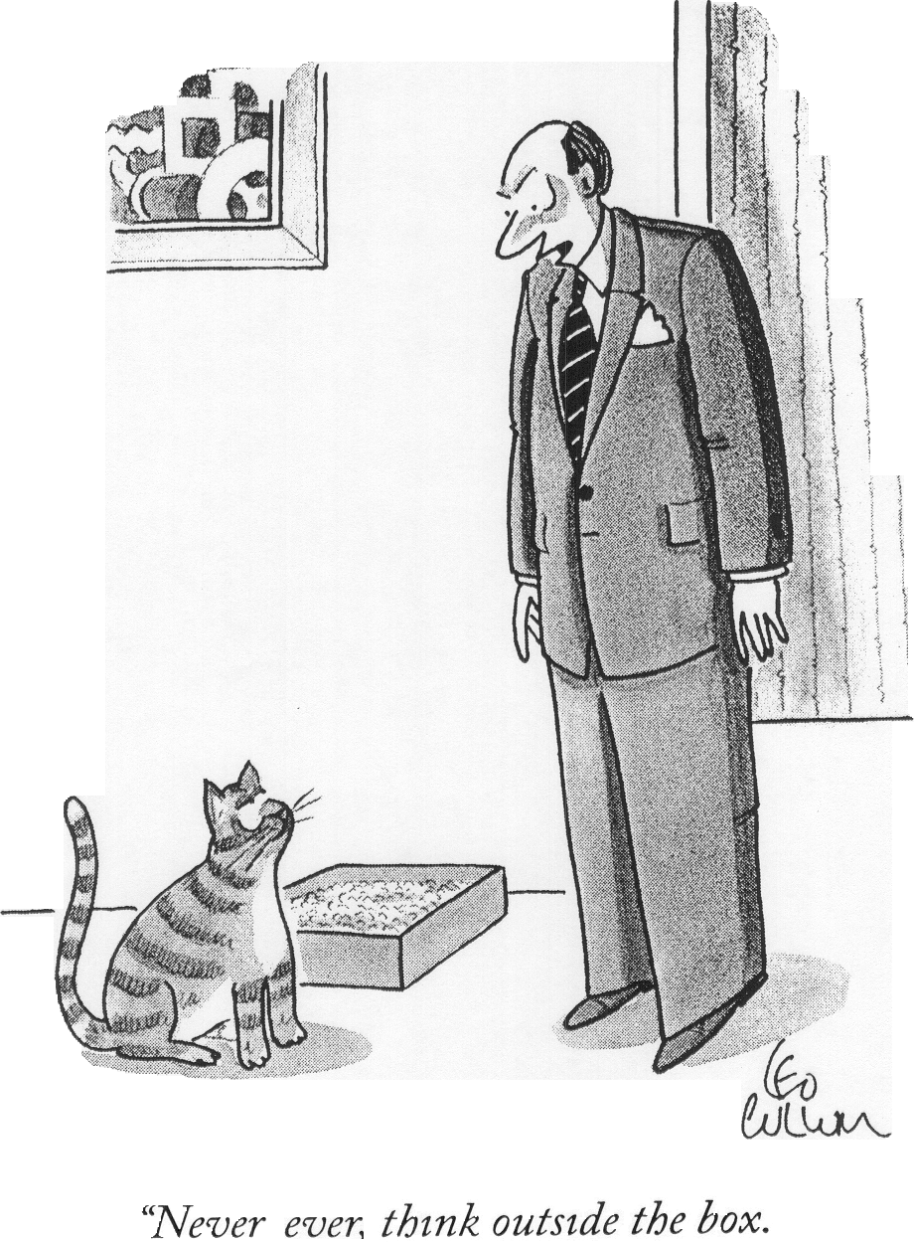

Slide 166
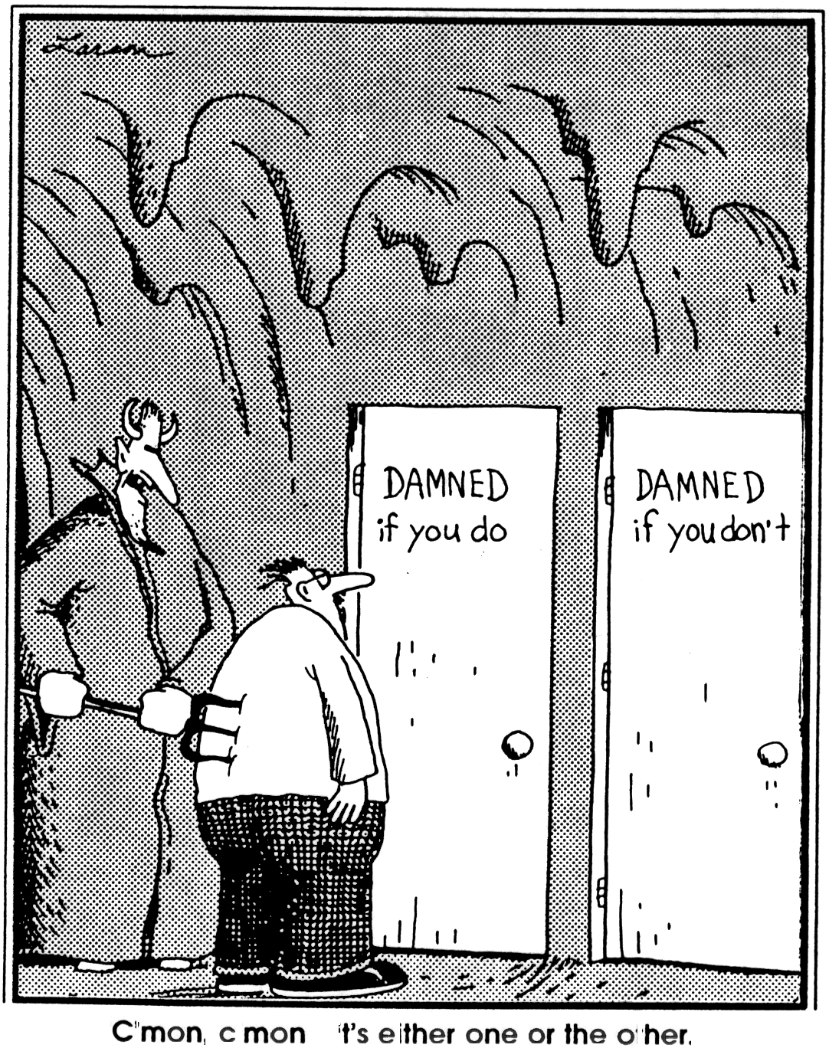
C’mon, c’mon. It’s either one or the other.

Slide 167
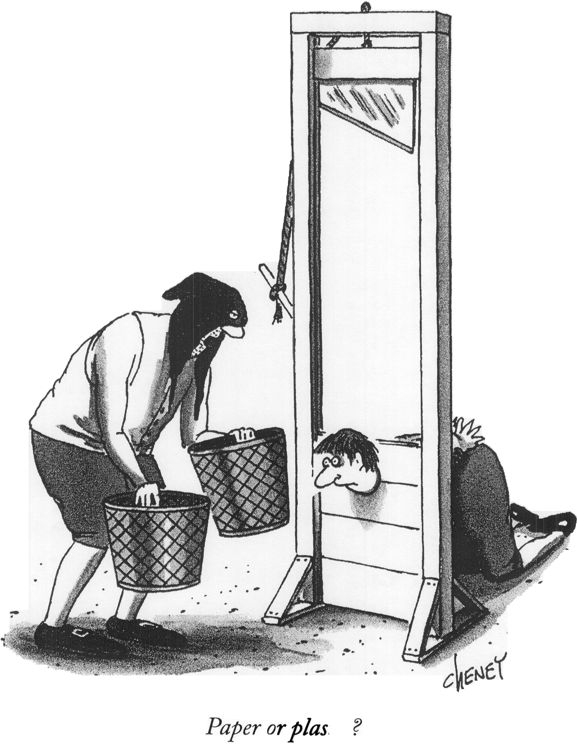
“Paper or plastic?”

Slide 168
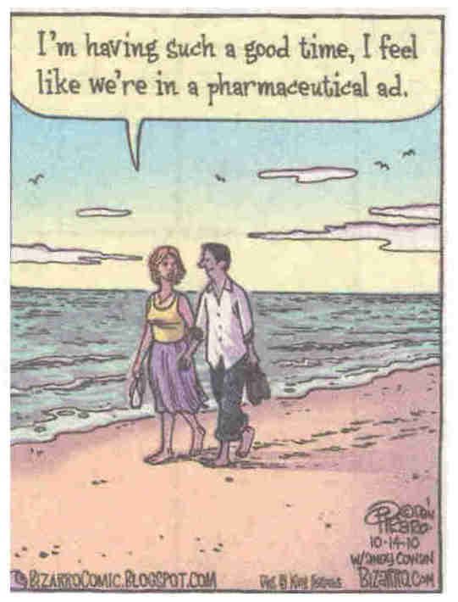

Slide 169
The Ecology of Medical Care
1000 persons
800 report symptoms
327 consider seeking medical care
217 visit a physician office (113 visit a primary care physician’s office) PBRN Research
65 visit a complementary or alternative medical care provider
21 visit a hospital outpatient clinic
14 receive home health care
13 visit an emergency dept
8 are hospitalized
<1 is hospitalized in an academic medical center Most Research
Results of a reanalysis of the monthly prevalence of illness in the community and the roles of various sources of health care. (Green LA et al., N Engl J Med 2001, 344:2021-2024)
Notes:
The slide shows the ecology of health care.
Within it, it contains the rationale for PBRNs.
Out of 1000 people living in community, in a given month:
800 report symptoms.
327 consider seeking medical care
217 visit a medical office – half of these are primary care
And so on..
Only 1 is hospitalized in an academic medical center. And yet, that is where we do almost all research.
If we want research to be relevant to practice and to where ‘most people get most of their care most of the time’ we need to frame and conduct the research in the box of 217.

Slide 170
Re-emerging Political Space for Linking Person and Community Through Primary Health Care
4 themes from national policy key informants:
Affirmation of primary care as the foundation of a more effective healthcare system
Patient-centered medical home is a transitional step to foster practice innovation & payment reform
Urgent need for an increased focus on community and population health in primary care
Ongoing need for advocacy and research efforts to keep primary care on & policy agendas.
Sweeney SA, Bazemore A, Phillips Jr. RL, Etz RS, Stange KC. A re-emerging political space for linking person and community through primary health care. Am J Prev Med, 2012; 42(6S2): S184-S190.

Slide 171

What is Health?
A state of complete physical, mental and social well-being and not merely the absence of disease or infirmity. (World Health Organization, 1947)
A resource for every day life, not the objective of living; it is a positive concept, emphasizing social and personal resources, as well as physical capacities. (Ottawa Charter for Health Promotion, 1986)
Conditions that enable a person to work to achieve his or her biological and chosen potential. (Seedhouse 2001)
Membership in a community. (Berry, 2002)
The biological, social, and psychological ability that affords an equal opportunity for each individual to function in the relationships appropriate to his or her cultural context at any point in the life cycle. (Fine & Peters, 2007)
The ability to develop meaningful relationships and pursue a transcendent purpose in a finite life. (Stange, 2010)

Slide 172
Global Typology of Primary Care Organisational Developments
Organisational Structure and Value Base Service Focus Location Endpoint
Type Process (examples)
Extended Simple Normative Registered Health Patient
general practice partnership patient list centre
Managed care Complex, Calculative Target groups Physicians User
enterprise stakeholder group
Reformed Coalition, Commercial Medical Multi- Client
polyclinic divisional conditions specialist
clinic
District health Hierarchic, Executive Public health General Populations
system administrative improvement hospital
Community Association, Affiliative Local Health Citizen
development network populations stations
agency
Franchised Quasi- Remunerative Payers Private, Customer
outreach institutional, hospital
virtual premises
Meads G (2006) Primary Care in the Twenty-First Century: An international perspective. Oxford: Radcliffe Publishing.

Slide 173
What do we mean by population health?
Goals
  Health as well-being for persons
  Population health as that goal expressed in measurable terms for groups
  Community health as population health for particular communities of interest, geography, or other defining characteristic-groups with shared identity and particular systemic influences on health
Realities
  Social determinants as influences
  Health disparities as effects
  Health equity as both a goal and a design principle
Ways to get the job done
  Health care delivery systems for enrollees
  Public health in population-based civic activities-with a broad zone of collaboration where streams of effort converge in partnership with served communities
Peek CJ, Westfall JM, Stange KC, et al. Shared language for shared work in population health. Ann Fam Med. 2021;19(5):450-457. www.ncbi.nlm.nih.gov/pubmed/34546952 .

