Slide 1
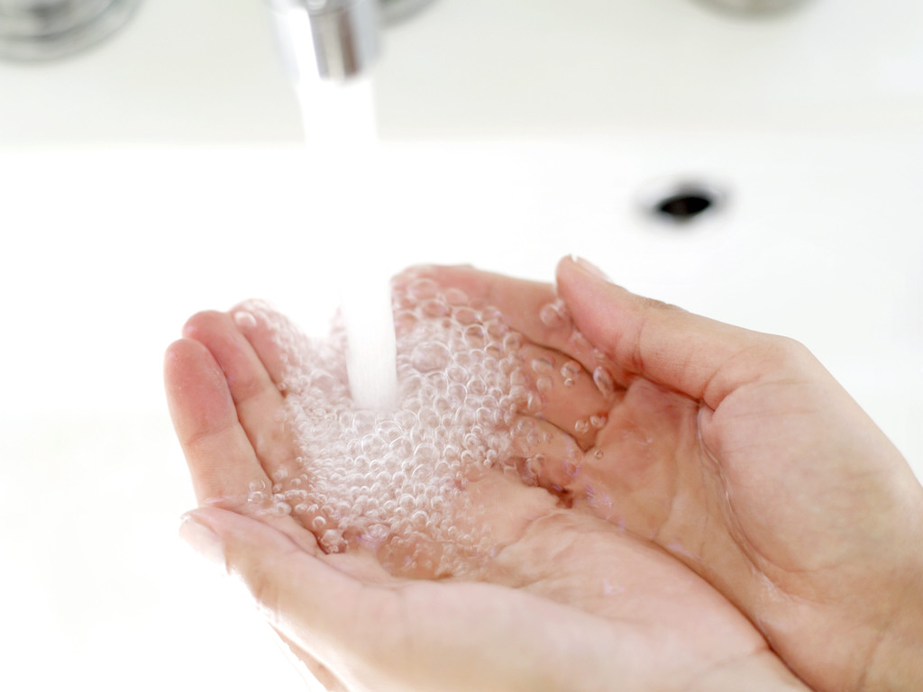
Hand Washing
The #1 standard precaution at UCLA Health System
Helps prevent spread of infectious diseases
Done both before and after patient contact for 15 seconds with warm water and soap

Slide 2
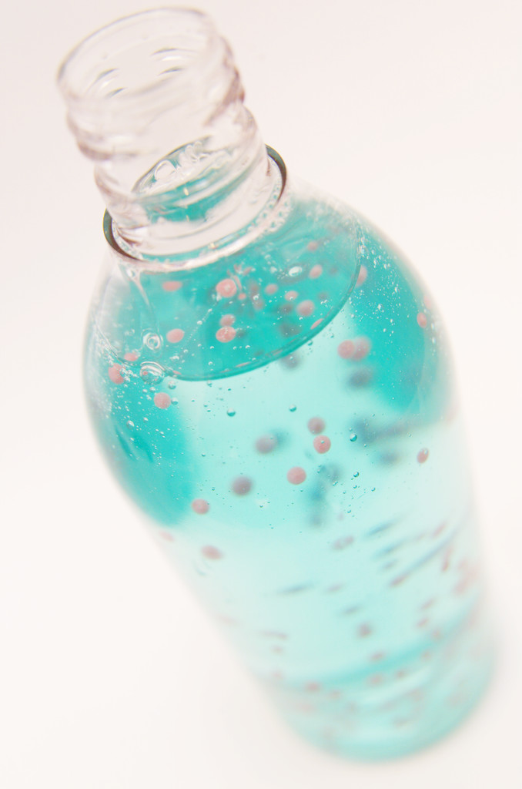
Alcohol Based Hand Rubs
Excellent to use if hands are not visibly soiled
Before & after contact with patients
After touching furniture or equipment near a patient
After removing gloves

Slide 3
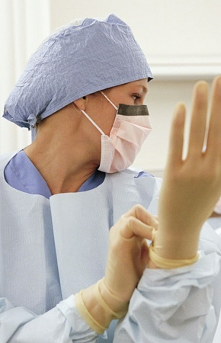
Isolation Rooms
Do not enter any isolation rooms, unless you are fitted and trained for Personal Protective Equipment (PPE).
Read the sign on the door.
A green sign indicates AIRBORNE isolation
A red sign: CONTACT isolation (i.e. “MRSA”)
A pink sign indicates SPORE isolation (CONTACT)

